Slide 1






Microsoft Azure AI Fundamentals
Mike Pfeiffer
Microsoft Azure MVP

Slide 2
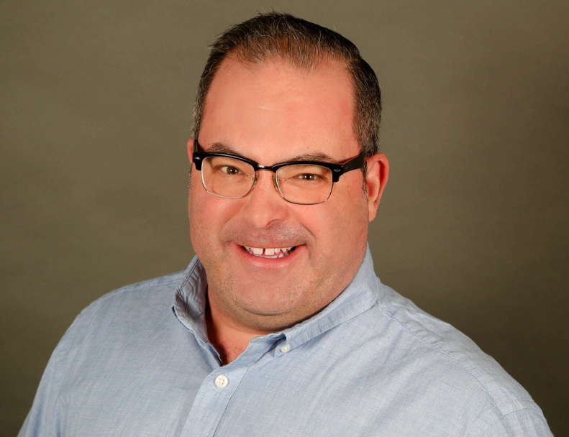

Tim Warner
Nashville, TN, US
Central time zone
Microsoft Certified Trainer (MCT)
Microsoft Most Valuable Professional (MVP)
Twitter: @TechTrainerTim
Badges: TechTrainerTim.com

Slide 3
Learning Goals
Introduction
Introduction to AI
Machine Learning
Computer Vision
Natural Language Processing (NLP)
Conversational AI

Slide 4
Course Materials
timw.info/ai900cs

Slide 5
Expectations
This is a "crash course"
Plan to review these materials more than once
10-minute breaks in AM and PM
30-minute lunch
Please ask/answer questions and provide feedback!

Slide 6
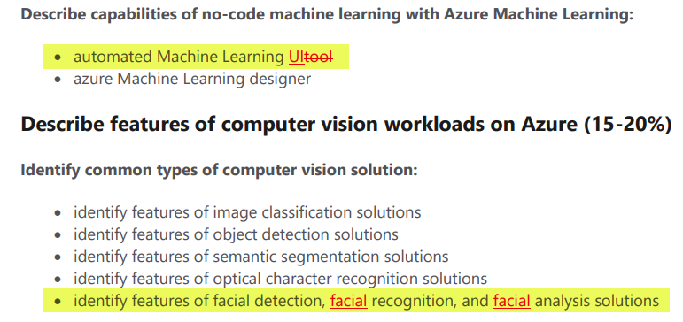
Exam AI-900 2021 Updates
Microsoft Worldwide Learning (WWL) revisits exam's objectives every 2 months
AI-900 was last updated October 22, 2020
The updates were trivial and cosmetic

Slide 7
Tim's Certification Study Pyramid
Interdependence
Content knowledge
Practical application
Test-taking skills

Slide 8
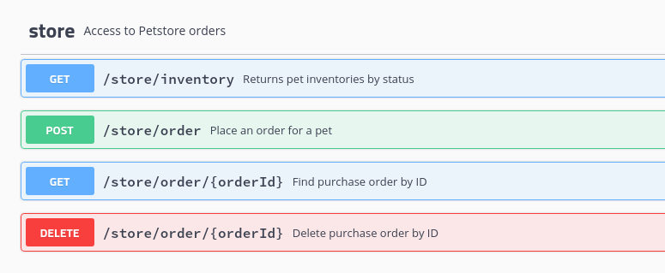
HTTP Methods
https://timw.info/cc6b1

Slide 9
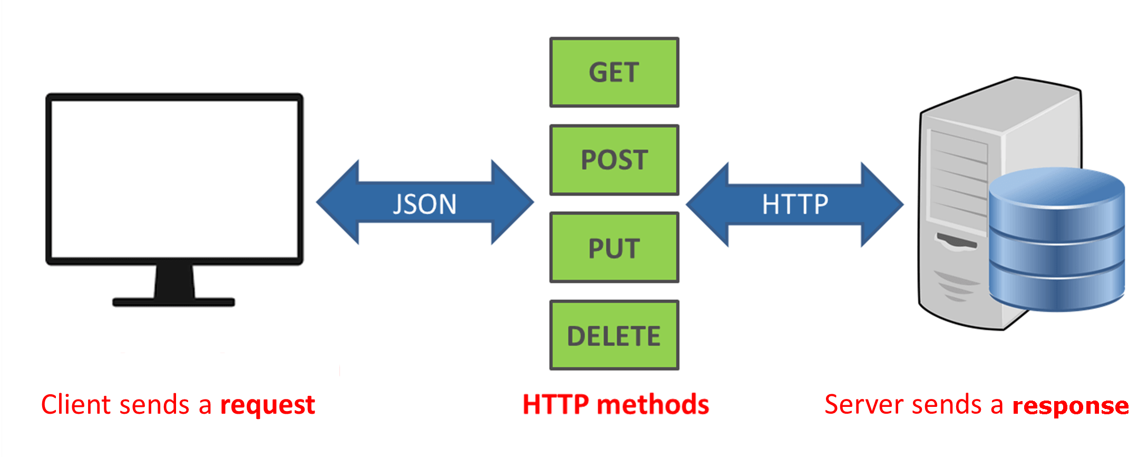
How a REST API Works
CRUD
https://timw.info/a850d

Slide 10

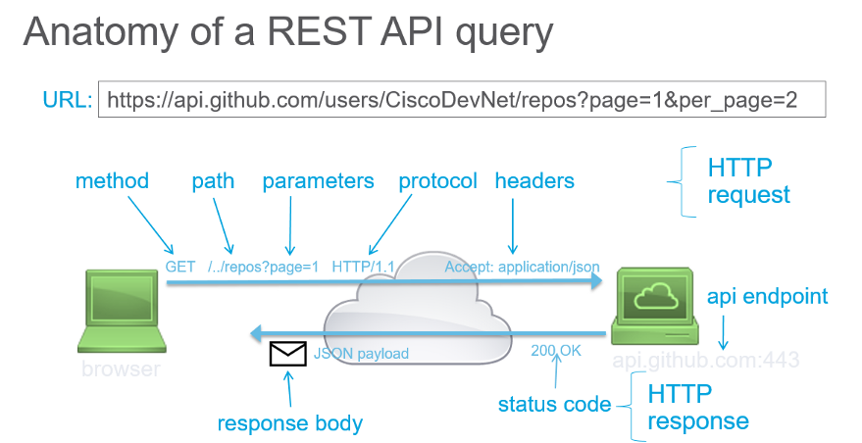
How a REST API Works
https://timw.info/d7a91

Slide 11






AI Workloads and Responsible AI

Slide 12

What is Artificial Intelligence?
Software that imitates human capabilities
Making decisions based on data and past experience
Recognizing abnormal events
Interpreting visual input
Understanding written and spoken language
Engaging in dialogs and conversations
Notes:
These are all things that most humans do on a day-to-day basis, often subconsciously:
We make decisions using the information we have available and our past experience to guide us.
We can intuitively know when something isn’t quite right, or doesn't fit an expected pattern.
We use sight to experience the world visually.
We communicate by writing and speaking
We are able to engage in dynamic conversations, responding appropriately.

Slide 13







Common AI Workloads
 | Machine Learning | Predictive models based on data and statistics – the foundation for AI
 | Anomaly Detection | Systems that detect unusual patterns or events, enabling pre-emptive action
 | Computer Vision | Applications that interpret visual input from cameras, images, or videos
 | Natural Language Processing | Applications that can interpret written or spoken language
 | Conversational AI | AI agents, (or bots), that can engage in dialogs with human users
Notes:
The slide lists common workloads or "areas" of AI, which correspond to the human traits on the previous slide.
We'll explore each of these workloads in detail, but for now just point out that in many solutions, the workloads may overlap.
For example, imagine a conversational AI solution that uses a bot to process an auto insurance claim. The bot relies on some natural language processing capabilities to make sense of input such as "I want to submit a claim". It may allow users to send a photograph of a damaged vehicle, use computer vision to assess the damage, and apply a machine learning model to predict likely repair costs. The bot might also use anomaly detection to identify potentially fraudulent claims.

Slide 14






AIin Microsoft Azure
Scalable, reliable cloud platform for AI
Data storage
Compute
Services
 | Azure Machine Learning | A platform for training, deploying, and managing machine learning models
 | Cognitive Services | A suite of services developers can use to build AI solutions
 | Azure Bot Service | A cloud-based platform for developing and managing bots
Notes:
Ask students about their existing level experience with Azure and cloud services in general, and if appropriate provide a quick demonstration of navigating the Azure portal at https://portal.azure.com.
The key Azure services that we'll explore in this course are:
Azure Machine Learning
Cognitive Services
Azure Bot Service

Slide 15
Responsible AI

Slide 16
Challenges and Risks with AI
Challenge or Risk | Example
Bias can affect results | A loan-approval model discriminates by gender due to bias in the data with which it was trained
Errors may cause harm | An autonomous vehicle experiences a system failure and causes a collision
Data could be exposed | A medical diagnostic bot is trained using sensitive patient data, which is stored insecurely
Solutions may not work for everyone | A predictive app provides no audio output for visually impaired users
Users must trust a complex system | An AI-based financial tool makes investment recommendations - what are they based on?
Who's liable for AI-driven decisions? | An innocent person is convicted of a crime based on evidence from facial recognition – who's responsible?
Notes:
Discuss each of the challenges / risks, encouraging students to think of additional examples.

Slide 17






Responsible AI Principles
Fairness
Reliability & Safety
Privacy & Security
Inclusiveness
Transparency
Accountability
https://www.microsoft.com/ai/responsible-ai
Notes:
At Microsoft, AI software development is guided by a set of six principles for responsible AI.
Use the summaries below to relate these to the challenges and risks on the previous slide.
Fairness AI systems should treat all people fairly. For example, suppose you create a machine learning model to support a loan approval application for a bank. The model should make predictions of whether or not the loan should be approved without incorporating any bias based on gender, ethnicity, or other factors that might result in an unfair advantage or disadvantage to specific groups of applicants.
Azure Machine Learning includes the capability to interpret models and quantify the extent to which each feature of the data influences the model's prediction. This capability helps data scientists and developers identify and mitigate bias in the model.
Reliability and safety AI systems should perform reliably and safely. For example, consider an AI-based software system for an autonomous vehicle; or a machine learning model that diagnoses patient symptoms and recommends prescriptions. Unreliability in these kinds of system can result in substantial risk to human life.
AI-based software application development must be subjected to rigorous testing and deployment management processes to ensure that they work as expected before release.
Privacy and security AI systems should be secure and respect privacy. The machine learning models on which AI systems are based rely on large volumes of data, which may contain personal details that must be kept private. Even after the models are trained and the system is in production, it uses new data to make predictions or take action that may be subject to privacy or security concerns.
Inclusiveness AI systems should empower everyone and engage people. AI should bring benefits to all parts of society, regardless of physical ability, gender, sexual orientation, ethnicity, or other factors.
Transparency AI systems should be understandable. Users should be made fully aware of the purpose of the system, how it works, and what limitations may be expected.
Accountability People should be accountable for AI systems. Designers and developers of AI-based solution should work within a framework of governance and organizational principles that ensure the solution meets ethical and legal standards that are clearly defined.

Slide 18
Azure Machine Learning

Slide 19








What is Machine Learning?
Creating predictive models by finding relationships in data
Bellis Perenis
Rosa Multiflora
Rosa Multiflora
Bellis Perenis
Tulipa
Bellis Perenis
Tulipa
Tulipa
Bellis Perenis
Rosa Multiflora
Notes:
This is an animated slide – use the notes below to talk to each animation build (clicks are indicated by numbers)
Machine Learning is a technique we can use to create predictive models based on relationships in data.
So what does that mean? Well, let's look at an example:
Suppose a botanist collects some samples of flowers. {The slide shows images of various flowers}
Each sample has some features, such as measurements of the petals, stem, and other details); and the botanist can provide a label for the flower using its species name. {The Latin name for each flower species appears}
The sample data is then processed using an algorithm that tries to find a relationship between the features and the label. {The flowers are fed into a pair of turning cogs}
The result of this algorithm is a machine learning model. {A human head with cogs for a brain appears}
And since the model has learned the relationship between the features and label, you can use it to predict the species of a flower based on its features. {A new flower appears, and the human head identifies its species}

Slide 20




Regression
56 | 115
61 | 126
67 | 137
72 | 140
76 | 152
82 | 156
x y
Training
ŷ
116
128
137
146
155
1.5
f(x)
1
35
f(x)=35 + 1.5x
54 | 114
62 | 129
68 | 130
74 | 152
80 | 154
Validation
Notes:
This is an animated slide – use the notes below to talk to each animation build (clicks are indicated by numbers)
One of the most common machine learning technique is called regression. You use regression when you want to predict a numeric value; like a price, a sales total, or some other measure.
Let's look at an example and get an idea of how it works. There's a little mathematics involved, but don't worry – the basic idea is fairly straightforward!
In this example, we'll imagine a bicycle rental company that wants to predict the number of rentals on a given day based on weather conditions.
We'll start with some historical data about cycle rentals. For this simple example, we'll restrict this to just the temperature and number of rentals per day. In reality there would be more factors to consider. {A table of data showing daily temperatures and the number of rentals appears}
The number of rentals is the label we're going to predict, and we're going to use the daily temperature as a feature on which to base the prediction. Generally, we refer to the feature (or features) as X and the label as Y; and what we're going to do is to try to figure out a function that we can apply to X to get the value of Y. This function will be the basis for a model that we can use to predict Y for any given value of X. {X appears above the temperature column, and Y appears above the rentals column}
When we find a function, we'll want to validate it with some data for days where we already know the number of rentals so we can see how well it predicts; so we'll split the data into a subset that we'll use the train the model, and hold back a subset for validation. {The table is split into a training subset and a validation subset}
To find an appropriate function, let's plot the X and Y values so we can visualize the relationship between them. {A chart showing X values plotted against Y values from the training subset is displayed
Looking at the plot, you can see a trend in which higher temperatures tend to correlate with more rentals. In fact, we can fit a line between the plotted points that more or less describes this correlation and we can use this line to work out a calculation that produces Y from X. The ability to use a line like this to define a function for the X/Y relationship is technically called linear regression; which sounds complicated, but let's look at the basic principle of how it works and hopefully you'll find that it's actually fairly intuitive. {A diagonal line showing a trend where high X values tend to correlate to high Y values is added to the chart}
The point where the line intercepts the Y axis is around 35… {The point where the line intersects the Y axis is highlighted on the chart}
…and the slope of the line is such that for every 1 unit of X it goes along, it goes up around 1.5 units of Y… {The slope of the line is shown by an arrow going left for 1 unit and an arrow going up for 1.5 units}
…so the function that operates on X to find Y is 35 plus 1.5 times X. {The function "f(x) = 35 + 1.4x" is displayed}
Now we can test that function with the validation data that we held back. Here are the values we get from the function for the temperatures on those days – because this is a prediction of Y rather than the actual Y value, we write it with a little "hat" and call it Y-hat. {A column of values calculated by using the function is added alongside the actual Y values in the validation subset}
Let's plot the actual values from the validation data along with the line from which the predicted values were calculated. {The actual values from the validation subset are plotted on the chart alongside the line that represents the predictive function}
Now we can see how well the model predicts by measuring the difference between the predicted values and the actual values that we know to be true – this tells us the amount of error in the model. There are various ways to calculate this error value and generate common metrics that we can use to evaluate a regression model. {Arrows indicating the distance between each actual value and the prediction function line are added to the chart}
This is a simple example, just to describe the general concepts and process for training and evaluating a regression model. In a real-world scenario, the training algorithm would need to fit multiple features (X values) to a regression function; but the basic principles remain the same. You start with some data that contains features and labels, you use some of the data to train a regression model by using an algorithm that tries to determine a function for X that predicts Y; and then you evaluate the trained model using the validation data that you held back. If you're happy with the level of error in the model, you can then use it to infer unknown label values in new cases.

Slide 21








Classification
Actual
[4,2,3.2,10] | 0
[6,3,1.7,12] | 1
[5,2,3.5,11] | 0
[4,1,2.9,10] | 0
[7,4,2.1,11] | 1
1
0
126
1
1
21
1
[7,3,1.8,11]
[7,4,2.1,11]
x y
Predicted
True Positive
7
119
1
1
0
[6,3,1.7,12]
Training
[4,8,2.5,10]
False Positive
[4,1,3,1,11]
[5,2,3.5,11]
False Negative
P(1) | P(0) | ŷ
0.2 | 0.8 | 0
0.9 | 0.1 | 1
0.6 | 0.4 | 1
0.3 | 0.7 | 0
[3,1,2.8,10] | 0
[7,3,1.8,11] | 1
[4,8,2.5,10] | 0
[4,1,3,1,11] | 1
[4,2,3.2,10]
[3,1,2.8,10]
True Negative
[4,1,2.9,10]
Validation
Notes:
This is an animated slide – use the notes below to talk to each animation build (clicks are indicated by numbers)
Regression is a form of supervised machine learning – in other words it relies on us having some data with known label values that we can fit to a model, which can then be applied to new data for which we don’t have the label values. Now let's look at another type of supervised machine learning – classification.
Again, there's some mathematics involved – in particular, probability. Don’t worry too much about the details – just remember that probability is always a value between 0 and 1, where 1 means a definite, 100% certainty.
Just as with regression, we start with some data that includes features and known labels. In this case, the features are medical measurements that might be taken during a health checkup – such as weight, height, blood pressure, and so on. This time, the label isn't a numeric value but an indicator of whether the patient is diabetic (in which case the label has a value of 1) or not (in which case it is 0). The label indicates to which class the patient belongs – diabetic or non-diabetic. {A table of data appears. In the first column, the values are vectors (lists) of diagnostic measurements. The second column contains a 1 or a 0}
Once again, we split the data into subsets for training and validation. {The table is split into training and validation subsets}
Now, we'll take the training values and apply an algorithm that fits them to a function so that the Y value is between 0 and 1, like this. {A chart showing the feature vectors plotted against the label values is displayed
Since the value can be anywhere between 0 and 1, a threshold value is used to determine the cut-off point where the class is considered to be 0 or 1. In this case, all patients with features producing a value greater than 0.5 are diabetic, and those with values below that threshold are not. {A line is added to the chart at the 0.5 threshold – all points plotted above this represent diabetic patients, and all points below represent non-diabetic patients}
The function we've fitted to the data is an example of a logistic function. You can think of the value as representing the probability that the class is 1 (in other words, that the patient is diabetic). {A Sigmoidal (s-shaped) function graph is shown with a minimum value of 0 and a maximum of 1}
Having determined a function that fits our features, a model is produced and we can use the validation data we held back to test it. Here are the results of applying the logistic model to our validation features. {The validation data points are plotted on the chart alongside the predictive function}
The function returns the probability that the class is 1, or positive, as a value between 0 and 1; and since there are only two possible classes, and there's a 100% probability that the patient is one of them (they're either diabetic or not!), the probability that the class is 0, or negative, is also known (it's just 1 minus the probability that it's positive) The class with the highest probability is the predicted value for Y. {A table showing the probability values for each possible class calculated by the function, and consequent 1 or 0 class prediction, is shown alongside the validation subset}
Let's look at the first validation case. In this case, the predicted class label is 0 and the actual label is also 0, so the model got it right. It's a true negative. {A tick appears alongside the first prediction}
The second case results in a prediction of 1 for an actual value of 1, so again it's correct – this time it's a true positive. {A tick appears alongside the second prediction}
For the third case, the prediction is 1 but the actual label is 0, so the model got this one wrong – it’s a false positive. {A cross appears alongside the third prediction}
The fourth one is also wrong – this time, a false negative. {A cross appears alongside the fourth prediction}
To evaluate the model, we tabulate the prediction results in a format called a confusion matrix, like this. {A 2 by 2 matrix of actual labels of 1 and 0 crossed with predicted labels of 1 and 0 is displayed, and the plotted points move to the appropriate quadrant of the matrix based on their predicted and actual values}
In a real scenario, you'd use much more validation data than we have on the slide, so it might end up looking something like this. {The numbers in the matrix increase to show 126 true positives, 7 false positives, 119 true negatives, and 21 false negatives}
If we apply a heatmap to this, intensifying the cells in the matrix to reflect the values, you can easily see that the correct predictions in the true positive and true negative cells form a dark diagonal line from top left to bottom right – indicating that the model got more predictions right than wrong. {The quadrants in the matrix are shaded, with higher values darker than lower values – this reveals a diagonal pattern of high values for true positives and true negatives}
From the values in the confusion matrix, you can calculate multiple metrics that can be used to measure the performance of the model.

Slide 22








Clustering
 | 6 | 3
 | 5 | 3
 | 2 | 3
 | 1 | 3
 | 3 | 8
 | 4 | 8
Notes:
This is an animated slide – use the notes below to talk to each animation build (clicks are indicated by numbers)
Regression and Classification are both forms of supervised machine learning.
Now let's look at a form of unsupervised machine learning – clustering.
Suppose we collect some observations of flowers, noting the height and number of petals for each sample. What we want to do is group flowers that are similar together, but we have no known label that we can use to train a model. {A table of flower heights and petal counts is shown}
Instead, we think of the feature values that we have as being coordinates on which we can plot the sample data points – in this case we have two features, height and petals, so we can plot them on a 2-dimensional grid like this. {A grid is shown with flowers plotted for each height and petal count coordinate pair}
Now we need to decide how many clusters we want to group the observations into. This value is generally referred to as K, and we simply assign K points at random locations on our grid like this. In this case, we've used a K value of 3; so we'll end up with 3 clusters. {Three centroid points are plotted on the grid at random coordinates}
Each of the K points we've plotted will be a centroid for a cluster, so we assign the sample data points to its nearest centroid. {Three shaded cluster areas enclosing the flowers that are nearest to each randomly plotted centroid is added}
Now we move each centroids to the middle of the points in its cluster – based on the mean distance. {The centroid points are moved to the center of the flowers in their cluster}
Now that the centroids have moved, some sample points might be nearer to a different centroid from the one they're currently allocated to; so we reallocate the samples to their nearest centroid. {The cluster shapes are redrawn to reflect the flowers that are now closest to each centroid}
And then we just repeat the process until the clusters are stable, or we reach a pre-determined maximum number of iterations. In this case, the clusters soon stabilize as well-separated groups of related flowers. {The centroids are iteratively moved to the middle of their cluster and the clusters reallocated until a stable set of separated clusters is defined and the centroids are fixed in the middle of their flowers}
This clustering technique, which uses K centroids and moves them to the mean distance between their data points is known as K-Means clustering.

Slide 23
Lesson 2 Azure Machine Learning

Slide 24







What is Azure Machine Learning?
A cloud-based platform for machine learning
Compute
Experiments
Services
Data
Models
Azure ML Workspace
Azure Subscription
Notes:
This is an animated slide – use the notes below to talk to each animation build (clicks are indicated by numbers)
Azure Machine Learning is a cloud-based platform for machine learning.
To use Azure Machine Learning, you need a Microsoft Azure subscription. {A cloud appears}
In that subscription, you create an Azure Machine Learning workspace. A workspace is a logical container for resources you need to manage machine learning projects. {Within the cloud, a rectangle representing a workspace appears}
One of the most important resources is compute. You need this to run machine learning workloads in the cloud instead of on your local computer. {Within the workspace, a computer appears}
You'll also need to manage the data you need to build machine learning solutions. {Within the workspace, a disk appears}
You can then use the data to run experiments on the compute resources. {Within the workspace, a graph appears}
Often, your experiments are used to train models; which you'll register and manage in your workspace. {Within the workspace, a model appears}
And when you're ready to use your models in applications, you can publish them as services that can be accessed over HTTP connections. {Within the workspace, a cog appears}
After talking through the slide animations, open the Azure portal (https://portal.azure.com) in a web browser and demonstrate the first few steps of creating an Azure Machine Learning workspace. Then use your existing workspace from your completion of the online learning path to demonstrate how to get from the Azure portal to Azure Machine Learning Studio (https://ml.azure.com) and show students the Compute, Data, Experiments, Models and Endpoints pages.

Slide 25



Automated Machine Learning
Takes the hard work out of machine learning
Supply the data and desired model type, and let Azure Machine Learning find the best model
Data
Model
Notes:
Automated Machine Learning in Azure Machine Learning provides the easiest way to train a machine learning model for regression or classification (or forecasting, which is really just regression with a time-series element). There's a visual interface for automated machine learning in the Azure Machine Learning studio web portal. You just need to supply the training data and select the required model type, and Azure ML does the rest.
Later, in the lab, students will get a chance to try this for themselves, but for now demonstrate the first few steps using your own Azure Machine Learning studio instance, cancelling before starting the training experiment, Then show students the result of the experiment you complete previously in the Use automated machine learning in Azure Machine Learning online module, demonstrating how to view the best model and its metrics. Finally, show the deployed endpoint and demonstrate the notebook used to consume it.

Slide 26
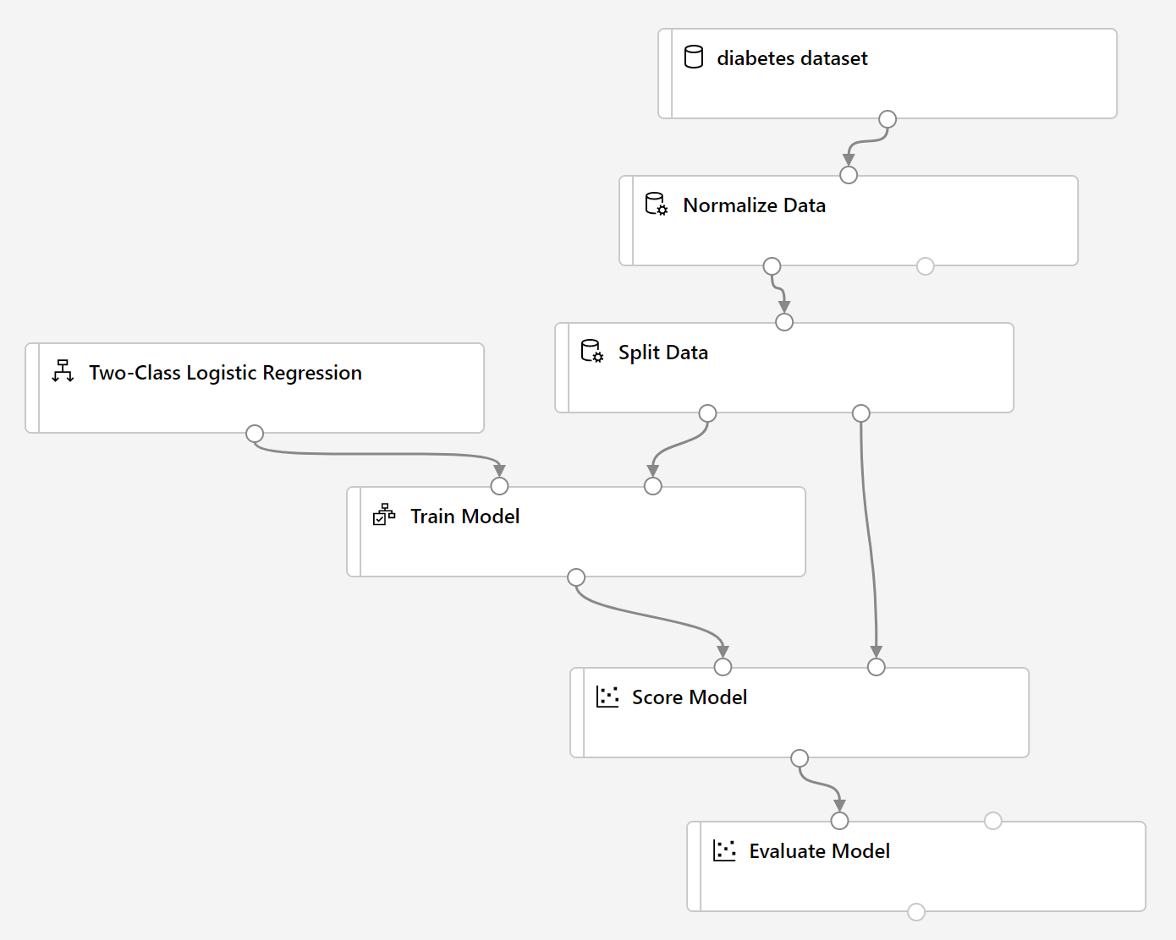
Azure Machine Learning designer
Visual tool for creating a machine learning pipeline
Use a training pipeline to train and evaluate a model
Create an inference pipeline to predict labels from new data
Deploy the inference pipeline as a service for apps to use
Notes:
In Azure Machine Learning, multi-step workflows to prepare data, train models, and perform model management tasks are called pipelines. The designer tool in Azure Machine Learning studio enables you to create and run pipelines by using a drag & drop visual interface to connect modules that define the steps and data flow for the pipeline.
You can either use the image on the slide and the notes below to describe the overall process, or use the training and inference pipelines you created when completing the Create a classification model with Azure Machine Learning designer online module to talk students through the end-to-end process, finishing with the deployed endpoint and the notebook code used to consume it.
On the left side of the slide, you can see the overall workflow for using designer:
Start by creating a pipeline that ingests and preprocesses a dataset before training and evaluating a model.
When you're happy with the model's performance, create an inference pipeline based on your training pipeline. This encapsulates the data preprocessing steps and the trained model so you can use it to predict labels for new data.
When the inference pipeline is ready, deploy it as a service that client applications can use.
On the right side of the slide, you can see an example of a training pipeline. Note the following key points about this:
The pipeline starts with a dataset – in this case containing patient data that includes a diabetes diagnosis (remember the classification example from earlier?)
Before training, data is usually preprocessed to clan it up or otherwise make it more suitable for modeling. In this case, the numeric features in the data (height, weight, diastolic blood pressure, and so on) are normalized – which means to convert them all to be on the same scale. This is a common preprocessing step for numeric features, and designer includes a Normalize Data module to do it.
Next, a Split Data module is used to randomly split the dataset into training and validation subsets. This is a common step in a supervised learning pipeline so that you can evaluate the model using data with which it wasn't trained.
The training subset is connected to a Train Model module, which in this case will fit the data to a function that predicts a diagnosis of diabetic or not-diabetic. This is a classification function with two possible classes, so an appropriate binary classification algorithm must be used to train the model. In this case, a Two-Class Logistic Regression algorithm has been used – but designer includes multiple, algorithm options you can choose from.
After training, a Score Model module is used to score the validation data (in other words, use the trained model to predict labels from the features).
The validation data includes the actual label value, so we can compare this to the predicted label produced by the Score Model module and use an Evaluate Model module to calculate metrics to help us determine if the model is any good or not. For a classification model like this, these metrics include simple accuracy as well as a confusion matrix of true positives, false positives, true negatives, and false negatives from which other, more discerning metrics can be derived.

Slide 27
Foundational Terminology

Slide 28
Machine Learning (ML)
Subset of AI that includes techniques that enable machines to improve at tasks with experience
Supervised
Regression: Predicting numeric data
Classification: Organizing non-numeric, discrete data
Unsupervised
Clustering
Pattern recognition

Slide 29
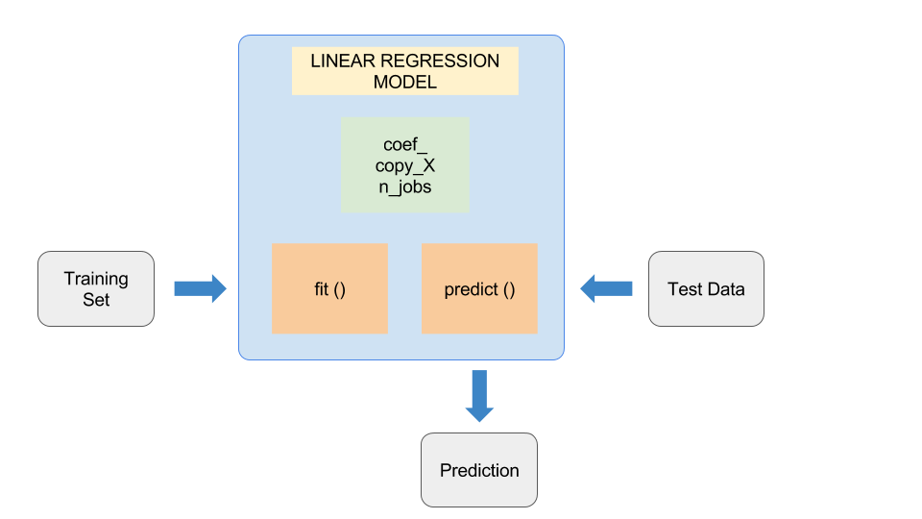
ML Model
Feature (Descriptive attribute) engineering vs. feature selection
Label: What you're trying to forecast
https://timw.info/37a04

Slide 30
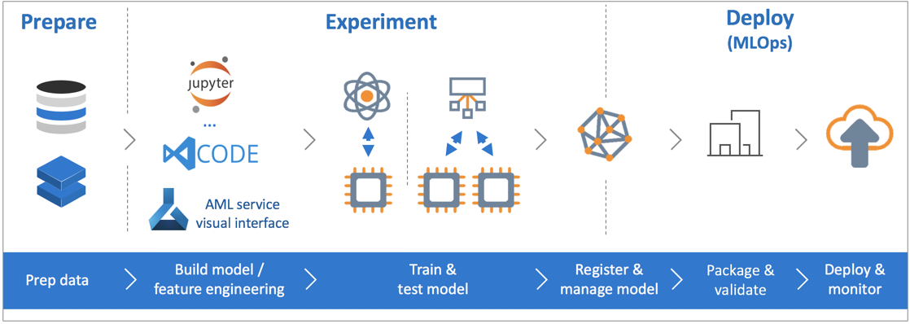
Azure Machine Learning Service
https://timw.info/de625

Slide 31
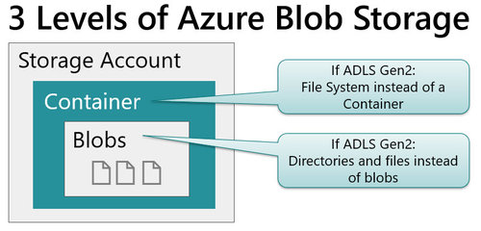
Blob Storage and Data Lake Storage
CSV, JSON
https://timw.info/772f8

Slide 32
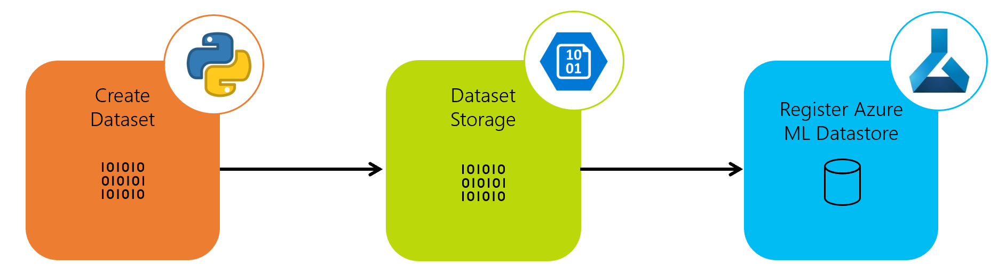
Azure ML Dataset & Datastore
A reference to your dataset in Azure storage
Authenticated context
https://timw.info/a1df2

Slide 33
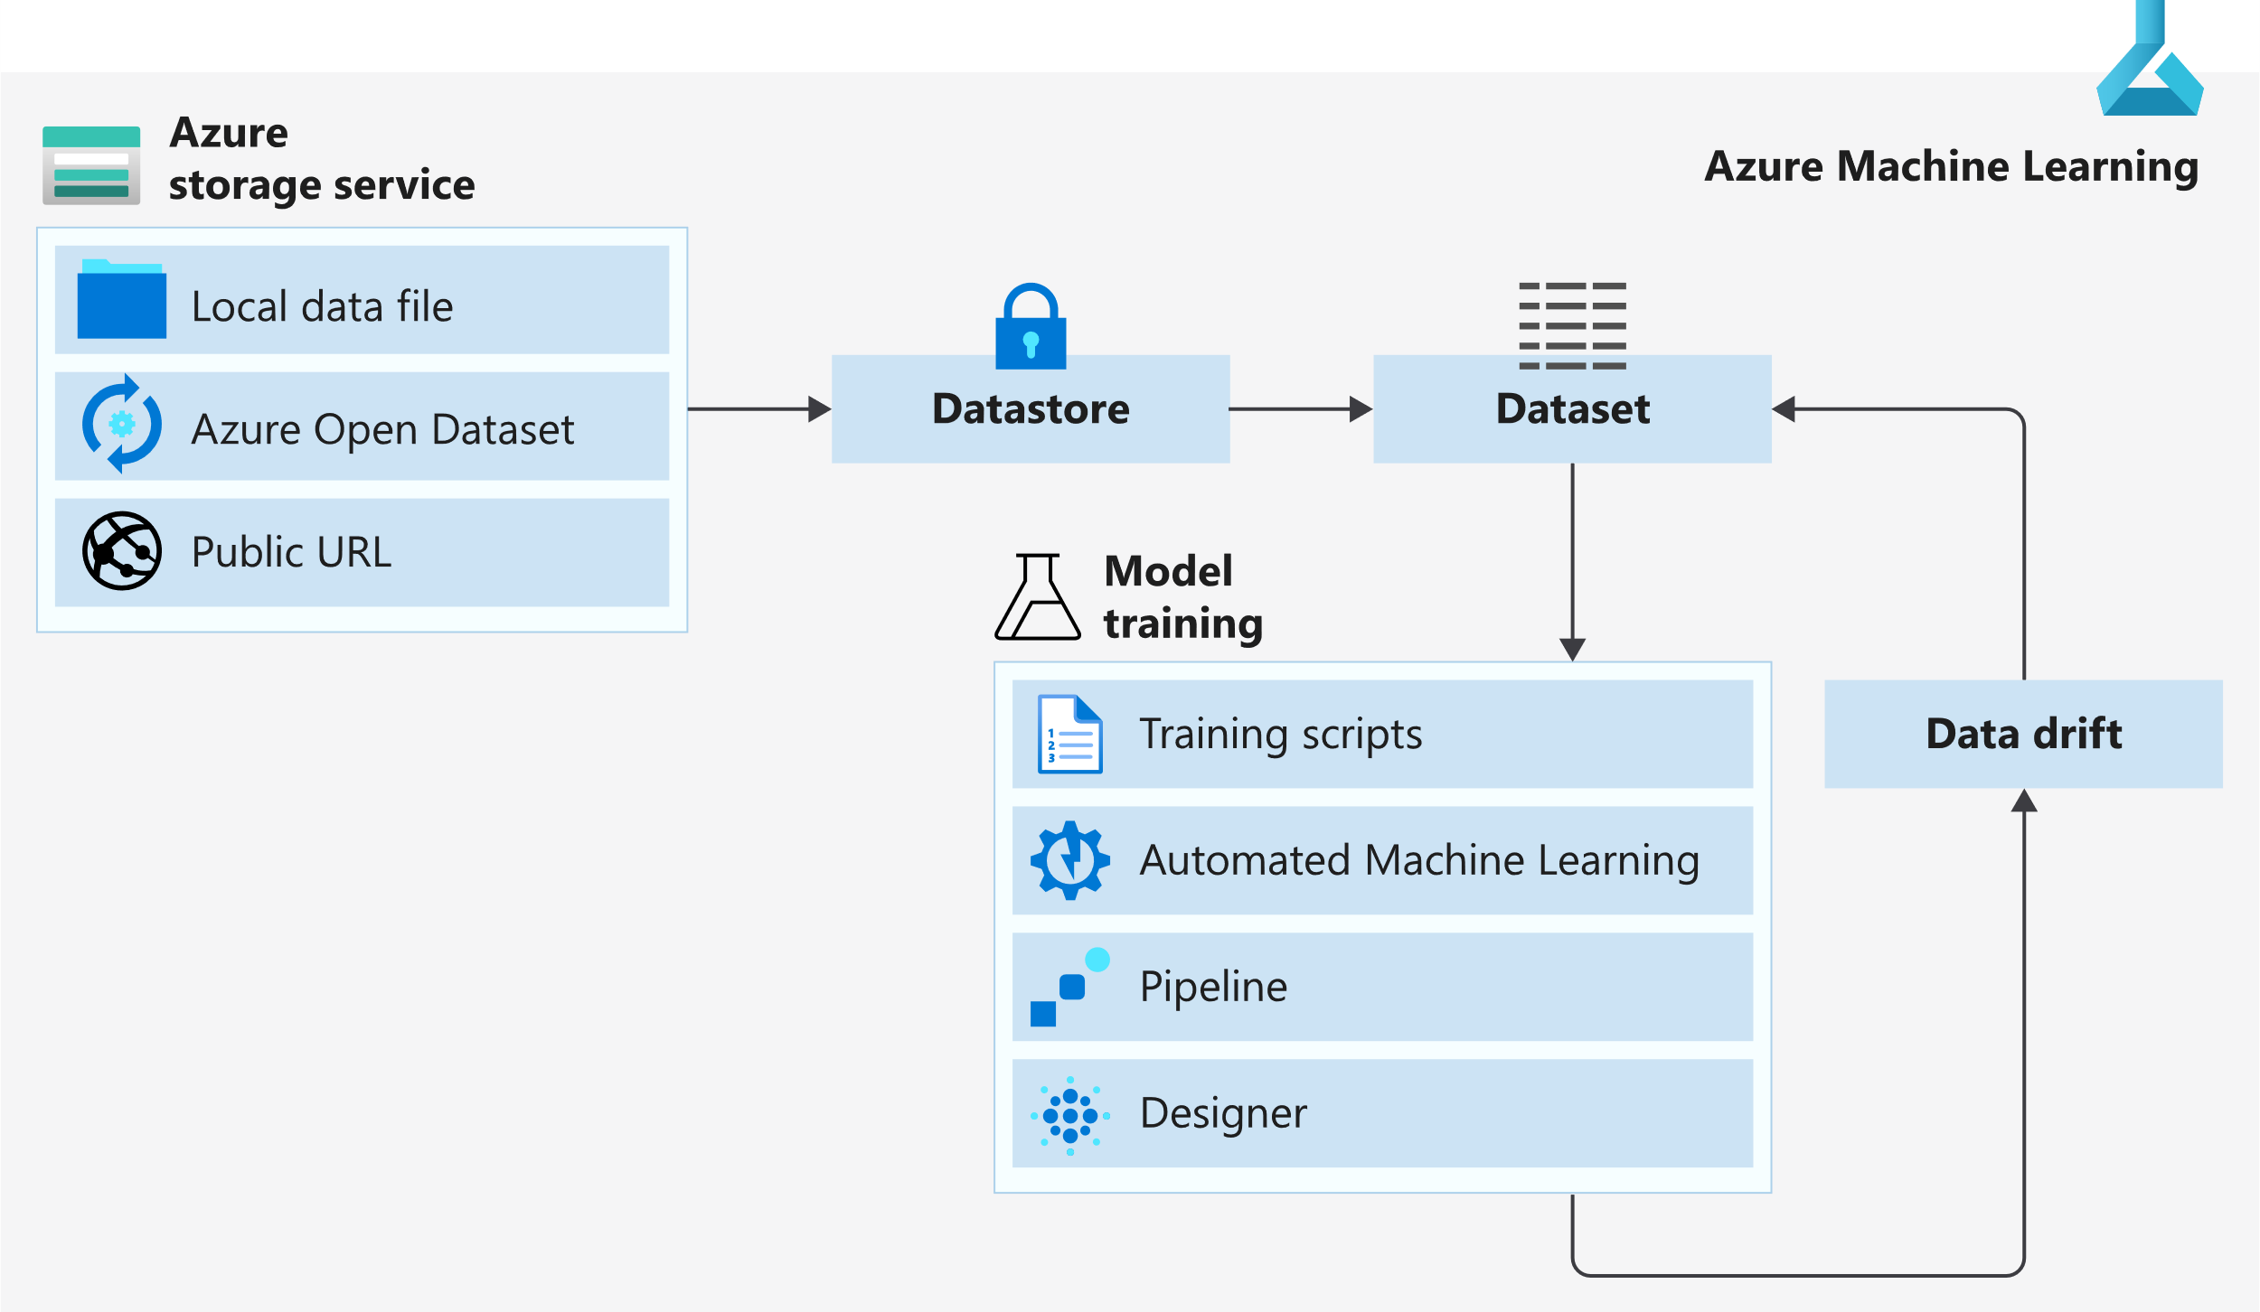
Azure ML Dataset & Datastore
https://timw.info/5a306

Slide 34
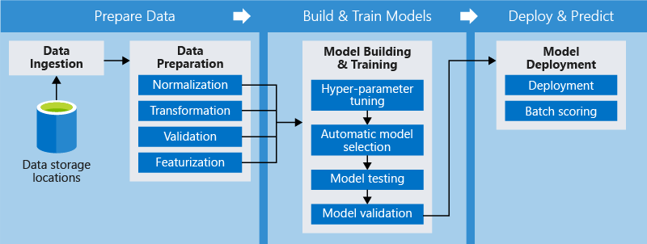
Azure ML Pipeline
https://timw.info/d572e

Slide 35
HTTP Methods
https://timw.info/cc6b1

Slide 36
How a REST API Works
CRUD
https://timw.info/a850d

Slide 37
How a REST API Works
https://timw.info/d7a91

Slide 38
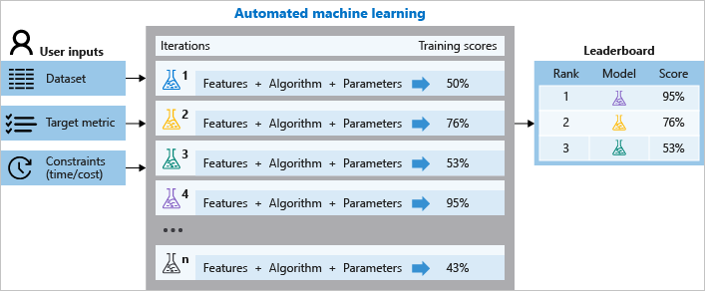
Azure Automated ML
Build ML models in a much more efficient manner
https://timw.info/aai3

Slide 39
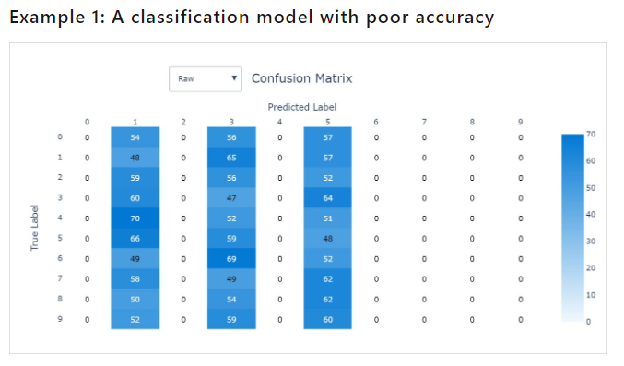
Validating AutoML Models
Confusion matrix
https://timw.info/26d20

Slide 40
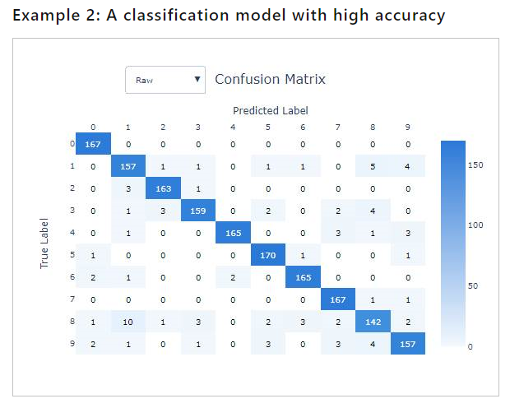
Validating AutoML Models
Confusion matrix
https://timw.info/26d20

Slide 41

Learning Objectives
You will learn the following concepts:
Introduction to machine learning
What is machine learning?
Regression
Classification
Clustering
Azure Machine Learning
What is Azure Machine Learning?
Automated Machine Learning
Azure Machine Learning designer

Slide 42
Computer Vision

Slide 43

Lesson 1 Computer Vision Concepts

Slide 44

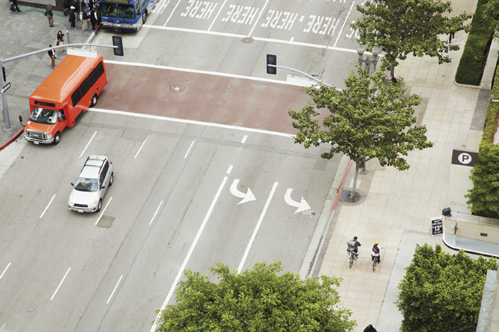


What is Computer Vision?
0 | 255 | 0 | 255 | 0 | 255 | 0 | 255 | 0 | 255 | 0 | 255 | 0 | 255 | 0 | 255 | 0 | 255 | 0 | 255 | 0 | 255 | 0 | 255 | 0 | 255 | 0 | 255 | 0 | 255 | 0 | 255 | 0 | 255 | 0 | 255 | 0
0 | 255 | 0 | 255 | 0 | 255 | 0 | 255 | 0 | 255 | 0 | 255 | 0 | 255 | 0 | 255 | 0 | 255 | 0 | 255 | 0 | 255 | 0 | 255 | 0 | 255 | 0 | 255 | 0 | 255 | 0 | 255 | 0 | 255 | 0 | 255 | 0
0 | 255 | 0 | 255 | 0 | 255 | 0 | 255 | 0 | 255 | 0 | 255 | 0 | 255 | 0 | 255 | 0 | 255 | 0 | 255 | 0 | 255 | 0 | 255 | 0 | 255 | 0 | 255 | 0 | 255 | 0 | 255 | 0 | 255 | 0 | 255 | 0
0 | 255 | 0 | 255 | 0 | 255 | 0 | 255 | 0 | 255 | 0 | 255 | 0 | 255 | 0 | 255 | 0 | 255 | 0 | 255 | 0 | 255 | 0 | 255 | 0 | 255 | 0 | 255 | 0 | 255 | 0 | 255 | 0 | 255 | 0 | 255 | 0
0 | 255 | 0 | 255 | 0 | 255 | 0 | 255 | 0 | 255 | 0 | 255 | 0 | 255 | 0 | 255 | 0 | 255 | 0 | 255 | 0 | 255 | 0 | 255 | 0 | 255 | 0 | 255 | 0 | 255 | 0 | 255 | 0 | 255 | 0 | 255 | 0
0 | 255 | 0 | 255 | 0 | 255 | 0 | 255 | 0 | 255 | 0 | 255 | 0 | 255 | 0 | 255 | 0 | 255 | 0 | 255 | 0 | 255 | 0 | 255 | 0 | 255 | 0 | 255 | 0 | 255 | 0 | 255 | 0 | 255 | 0 | 255 | 0
0 | 255 | 0 | 255 | 0 | 255 | 0 | 255 | 0 | 255 | 0 | 255 | 0 | 255 | 0 | 255 | 0 | 255 | 0 | 255 | 0 | 255 | 0 | 255 | 0 | 255 | 0 | 255 | 0 | 255 | 0 | 255 | 0 | 255 | 0 | 255 | 0
0 | 255 | 0 | 255 | 0 | 255 | 0 | 255 | 0 | 255 | 0 | 255 | 0 | 255 | 0 | 255 | 0 | 255 | 0 | 255 | 0 | 255 | 0 | 255 | 0 | 255 | 0 | 255 | 0 | 255 | 0 | 255 | 0 | 255 | 0 | 255 | 0
0 | 255 | 0 | 255 | 0 | 255 | 0 | 255 | 0 | 255 | 0 | 255 | 0 | 255 | 0 | 255 | 0 | 255 | 0 | 255 | 0 | 255 | 0 | 255 | 0 | 255 | 0 | 255 | 0 | 255 | 0 | 255 | 0 | 255 | 0 | 255 | 0
0 | 255 | 0 | 255 | 0 | 255 | 0 | 255 | 0 | 255 | 0 | 255 | 0 | 255 | 0 | 255 | 0 | 255 | 0 | 255 | 0 | 255 | 0 | 255 | 0 | 255 | 0 | 255 | 0 | 255 | 0 | 255 | 0 | 255 | 0 | 255 | 0
0 | 255 | 0 | 255 | 0 | 255 | 0 | 255 | 0 | 255 | 0 | 255 | 0 | 255 | 0 | 255 | 0 | 255 | 0 | 255 | 0 | 255 | 0 | 255 | 0 | 255 | 0 | 255 | 0 | 255 | 0 | 255 | 0 | 255 | 0 | 255 | 0
0 | 255 | 0 | 255 | 0 | 255 | 0 | 255 | 0 | 255 | 0 | 255 | 0 | 255 | 0 | 255 | 0 | 255 | 0 | 255 | 0 | 255 | 0 | 255 | 0 | 255 | 0 | 255 | 0 | 255 | 0 | 255 | 0 | 255 | 0 | 255 | 0
0 | 255 | 0 | 255 | 0 | 255 | 0 | 255 | 0 | 255 | 0 | 255 | 0 | 255 | 0 | 255 | 0 | 255 | 0 | 255 | 0 | 255 | 0 | 255 | 0 | 255 | 0 | 255 | 0 | 255 | 0 | 255 | 0 | 255 | 0 | 255 | 0
0 | 255 | 0 | 255 | 0 | 255 | 0 | 255 | 0 | 255 | 0 | 255 | 0 | 255 | 0 | 255 | 0 | 255 | 0 | 255 | 0 | 255 | 0 | 255 | 0 | 255 | 0 | 255 | 0 | 255 | 0 | 255 | 0 | 255 | 0 | 255 | 0
0 | 255 | 0 | 255 | 0 | 255 | 0 | 255 | 0 | 255 | 0 | 255 | 0 | 255 | 0 | 255 | 0 | 255 | 0 | 255 | 0 | 255 | 0 | 255 | 0 | 255 | 0 | 255 | 0 | 255 | 0 | 255 | 0 | 255 | 0 | 255 | 0
0 | 255 | 0 | 255 | 0 | 255 | 0 | 255 | 0 | 255 | 0 | 255 | 0 | 255 | 0 | 255 | 0 | 255 | 0 | 255 | 0 | 255 | 0 | 255 | 0 | 255 | 0 | 255 | 0 | 255 | 0 | 255 | 0 | 255 | 0 | 255 | 0
0 | 255 | 0 | 255 | 0 | 255 | 0 | 255 | 0 | 255 | 0 | 255 | 0 | 255 | 0 | 255 | 0 | 255 | 0 | 255 | 0 | 255 | 0 | 255 | 0 | 255 | 0 | 255 | 0 | 255 | 0 | 255 | 0 | 255 | 0 | 255 | 0
0 | 255 | 0 | 255 | 0 | 255 | 0 | 255 | 0 | 255 | 0 | 255 | 0 | 255 | 0 | 255 | 0 | 255 | 0 | 255 | 0 | 255 | 0 | 255 | 0 | 255 | 0 | 255 | 0 | 255 | 0 | 255 | 0 | 255 | 0 | 255 | 0
0 | 255 | 0 | 255 | 0 | 255 | 0 | 255 | 0 | 255 | 0 | 255 | 0 | 255 | 0 | 255 | 0 | 255 | 0 | 255 | 0 | 255 | 0 | 255 | 0 | 255 | 0 | 255 | 0 | 255 | 0 | 255 | 0 | 255 | 0 | 255 | 0
0 | 255 | 0 | 255 | 0 | 255 | 0 | 255 | 0 | 255 | 0 | 255 | 0 | 255 | 0 | 255 | 0 | 255 | 0 | 255 | 0 | 255 | 0 | 255 | 0 | 255 | 0 | 255 | 0 | 255 | 0 | 255 | 0 | 255 | 0 | 255 | 0
0 | 255 | 0 | 255 | 0 | 255 | 0 | 255 | 0 | 255 | 0 | 255 | 0 | 255 | 0 | 255 | 0 | 255 | 0 | 255 | 0 | 255 | 0 | 255 | 0 | 255 | 0 | 255 | 0 | 255 | 0 | 255 | 0 | 255 | 0 | 255 | 0
0 | 255 | 0 | 255 | 0 | 255 | 0 | 255 | 0 | 255 | 0 | 255 | 0 | 255 | 0 | 255 | 0 | 255 | 0 | 255 | 0 | 255 | 0 | 255 | 0 | 255 | 0 | 255 | 0 | 255 | 0 | 255 | 0 | 255 | 0 | 255 | 0
0 | 255 | 0 | 255 | 0 | 255 | 0 | 255 | 0 | 255 | 0 | 255 | 0 | 255 | 0 | 255 | 0 | 255 | 0 | 255 | 0 | 255 | 0 | 255 | 0 | 255 | 0 | 255 | 0 | 255 | 0 | 255 | 0 | 255 | 0 | 255 | 0
0 | 255 | 0 | 255 | 0 | 255 | 0 | 255 | 0 | 255 | 0 | 255 | 0 | 255 | 0 | 255 | 0 | 255 | 0 | 255 | 0 | 255 | 0 | 255 | 0 | 255 | 0 | 255 | 0 | 255 | 0 | 255 | 0 | 255 | 0 | 255 | 0
0 | 255 | 0 | 255 | 0 | 255 | 0 | 255 | 0 | 255 | 0 | 255 | 0 | 255 | 0 | 255 | 0 | 255 | 0 | 255 | 0 | 255 | 0 | 255 | 0 | 255 | 0 | 255 | 0 | 255 | 0 | 255 | 0 | 255 | 0 | 255 | 0
0 | 255 | 0 | 255 | 0 | 255 | 0 | 255 | 0 | 255 | 0 | 255 | 0 | 255 | 0 | 255 | 0 | 255 | 0 | 255 | 0 | 255 | 0 | 255 | 0 | 255 | 0 | 255 | 0 | 255 | 0 | 255 | 0 | 255 | 0 | 255 | 0
0 | 255 | 0 | 255 | 0 | 255 | 0 | 255 | 0 | 255 | 0 | 255 | 0 | 255 | 0 | 255 | 0 | 255 | 0 | 255 | 0 | 255 | 0 | 255 | 0 | 255 | 0 | 255 | 0 | 255 | 0 | 255 | 0 | 255 | 0 | 255 | 0
0 | 255 | 0 | 255 | 0 | 255 | 0 | 255 | 0 | 255 | 0 | 255 | 0 | 255 | 0 | 255 | 0 | 255 | 0 | 255 | 0 | 255 | 0 | 255 | 0 | 255 | 0 | 255 | 0 | 255 | 0 | 255 | 0 | 255 | 0 | 255 | 0
0 | 255 | 0 | 255 | 0 | 255 | 0 | 255 | 0 | 255 | 0 | 255 | 0 | 255 | 0 | 255 | 0 | 255 | 0 | 255 | 0 | 255 | 0 | 255 | 0 | 255 | 0 | 255 | 0 | 255 | 0 | 255 | 0 | 255 | 0 | 255 | 0
0 | 255 | 0 | 255 | 0 | 255 | 0 | 255 | 0 | 255 | 0 | 255 | 0 | 255 | 0 | 255 | 0 | 255 | 0 | 255 | 0 | 255 | 0 | 255 | 0 | 255 | 0 | 255 | 0 | 255 | 0 | 255 | 0 | 255 | 0 | 255 | 0
0 | 255 | 0 | 255 | 0 | 255 | 0 | 255 | 0 | 255 | 0 | 255 | 0 | 255 | 0 | 255 | 0 | 255 | 0 | 255 | 0 | 255 | 0 | 255 | 0 | 255 | 0 | 255 | 0 | 255 | 0 | 255 | 0 | 255 | 0 | 255 | 0
0 | 255 | 0 | 255 | 0 | 255 | 0 | 255 | 0 | 255 | 0 | 255 | 0 | 255 | 0 | 255 | 0 | 255 | 0 | 255 | 0 | 255 | 0 | 255 | 0 | 255 | 0 | 255 | 0 | 255 | 0 | 255 | 0 | 255 | 0 | 255 | 0
0 | 255 | 0 | 255 | 0 | 255 | 0 | 255 | 0 | 255 | 0 | 255 | 0 | 255 | 0 | 255 | 0 | 255 | 0 | 255 | 0 | 255 | 0 | 255 | 0 | 255 | 0 | 255 | 0 | 255 | 0 | 255 | 0 | 255 | 0 | 255 | 0
0 | 255 | 0 | 255 | 0 | 255 | 0 | 255 | 0 | 255 | 0 | 255 | 0 | 255 | 0 | 255 | 0 | 255 | 0 | 255 | 0 | 255 | 0 | 255 | 0 | 255 | 0 | 255 | 0 | 255 | 0 | 255 | 0 | 255 | 0 | 255 | 0
0 | 255 | 0 | 255 | 0 | 255 | 0 | 255 | 0 | 255 | 0 | 255 | 0 | 255 | 0 | 255 | 0 | 255 | 0 | 255 | 0 | 255 | 0 | 255 | 0 | 255 | 0 | 255 | 0 | 255 | 0 | 255 | 0 | 255 | 0 | 255 | 0
0 | 255 | 0 | 255 | 0 | 255 | 0 | 255 | 0 | 255 | 0 | 255 | 0 | 255 | 0 | 255 | 0 | 255 | 0 | 255 | 0 | 255 | 0 | 255 | 0 | 255 | 0 | 255 | 0 | 255 | 0 | 255 | 0 | 255 | 0 | 255 | 0
0 | 255 | 0 | 255 | 0 | 255 | 0 | 255 | 0 | 255 | 0 | 255 | 0 | 255 | 0 | 255 | 0 | 255 | 0 | 255 | 0 | 255 | 0 | 255 | 0 | 255 | 0 | 255 | 0 | 255 | 0 | 255 | 0 | 255 | 0 | 255 | 0
0 | 255 | 0 | 255 | 0 | 255 | 0 | 255 | 0 | 255 | 0 | 255 | 0 | 255 | 0 | 255 | 0 | 255 | 0 | 255 | 0 | 255 | 0 | 255 | 0 | 255 | 0 | 255 | 0 | 255 | 0 | 255 | 0 | 255 | 0 | 255 | 0
0 | 255 | 0 | 255 | 0 | 255 | 0 | 255 | 0 | 255 | 0 | 255 | 0 | 255 | 0 | 255 | 0 | 255 | 0 | 255 | 0 | 255 | 0 | 255 | 0 | 255 | 0 | 255 | 0 | 255 | 0 | 255 | 0 | 255 | 0 | 255 | 0
0 | 255 | 0 | 255 | 0 | 255 | 0 | 255 | 0 | 255 | 0 | 255 | 0 | 255 | 0 | 255 | 0 | 255 | 0 | 255 | 0 | 255 | 0 | 255 | 0 | 255 | 0 | 255 | 0 | 255 | 0 | 255 | 0 | 255 | 0 | 255 | 0
0 | 255 | 0 | 255 | 0 | 255 | 0 | 255 | 0 | 255 | 0 | 255 | 0 | 255 | 0 | 255 | 0 | 255 | 0 | 255 | 0 | 255 | 0 | 255 | 0 | 255 | 0 | 255 | 0 | 255 | 0 | 255 | 0 | 255 | 0 | 255 | 0
0 | 255 | 0 | 255 | 0 | 255 | 0 | 255 | 0 | 255 | 0 | 255 | 0 | 255 | 0 | 255 | 0 | 255 | 0 | 255 | 0 | 255 | 0 | 255 | 0 | 255 | 0 | 255 | 0 | 255 | 0 | 255 | 0 | 255 | 0 | 255 | 0
0 | 255 | 0 | 255 | 0 | 255 | 0 | 255 | 0 | 255 | 0 | 255 | 0 | 255 | 0 | 255 | 0 | 255 | 0 | 255 | 0 | 255 | 0 | 255 | 0 | 255 | 0 | 255 | 0 | 255 | 0 | 255 | 0 | 255 | 0 | 255 | 0
0 | 255 | 0 | 255 | 0 | 255 | 0 | 255 | 0 | 255 | 0 | 255 | 0 | 255 | 0 | 255 | 0 | 255 | 0 | 255 | 0 | 255 | 0 | 255 | 0 | 255 | 0 | 255 | 0 | 255 | 0 | 255 | 0 | 255 | 0 | 255 | 0
0 | 255 | 0 | 255 | 0 | 255 | 0 | 255 | 0 | 255 | 0 | 255 | 0 | 255 | 0 | 255 | 0 | 255 | 0 | 255 | 0 | 255 | 0 | 255 | 0 | 255 | 0 | 255 | 0 | 255 | 0 | 255 | 0 | 255 | 0 | 255 | 0
0 | 255 | 0 | 255 | 0 | 255 | 0 | 255 | 0 | 255 | 0 | 255 | 0 | 255 | 0 | 255 | 0 | 255 | 0 | 255 | 0 | 255 | 0 | 255 | 0 | 255 | 0 | 255 | 0 | 255 | 0 | 255 | 0 | 255 | 0 | 255 | 0
0 | 255 | 0 | 255 | 0 | 255 | 0 | 255 | 0 | 255 | 0 | 255 | 0 | 255 | 0 | 255 | 0 | 255 | 0 | 255 | 0 | 255 | 0 | 255 | 0 | 255 | 0 | 255 | 0 | 255 | 0 | 255 | 0 | 255 | 0 | 255 | 0
0 | 255 | 0 | 255 | 0 | 255 | 0 | 255 | 0 | 255 | 0 | 255 | 0 | 255 | 0 | 255 | 0 | 255 | 0 | 255 | 0 | 255 | 0 | 255 | 0 | 255 | 0 | 255 | 0 | 255 | 0 | 255 | 0 | 255 | 0 | 255 | 0
0 | 255 | 0 | 255 | 0 | 255 | 0 | 255 | 0 | 255 | 0 | 255 | 0 | 255 | 0 | 255 | 0 | 255 | 0 | 255 | 0 | 255 | 0 | 255 | 0 | 255 | 0 | 255 | 0 | 255 | 0 | 255 | 0 | 255 | 0 | 255 | 0
0 | 255 | 0 | 255 | 0 | 255 | 0 | 255 | 0 | 255 | 0 | 255 | 0 | 255 | 0 | 255 | 0 | 255 | 0 | 255 | 0 | 255 | 0 | 255 | 0 | 255 | 0 | 255 | 0 | 255 | 0 | 255 | 0 | 255 | 0 | 255 | 0
0 | 255 | 0 | 255 | 0 | 255 | 0 | 255 | 0 | 255 | 0 | 255 | 0 | 255 | 0 | 255 | 0 | 255 | 0 | 255 | 0 | 255 | 0 | 255 | 0 | 255 | 0 | 255 | 0 | 255 | 0 | 255 | 0 | 255 | 0 | 255 | 0
0 | 255 | 0 | 255 | 0 | 255 | 0 | 255 | 0 | 255 | 0 | 255 | 0 | 255 | 0 | 255 | 0 | 255 | 0 | 255 | 0 | 255 | 0 | 255 | 0 | 255 | 0 | 255 | 0 | 255 | 0 | 255 | 0 | 255 | 0 | 255 | 0
0 | 255 | 0 | 255 | 0 | 255 | 0 | 255 | 0 | 255 | 0 | 255 | 0 | 255 | 0 | 255 | 0 | 255 | 0 | 255 | 0 | 255 | 0 | 255 | 0 | 255 | 0 | 255 | 0 | 255 | 0 | 255 | 0 | 255 | 0 | 255 | 0
0 | 255 | 0 | 255 | 0 | 255 | 0 | 255 | 0 | 255 | 0 | 255 | 0 | 255 | 0 | 255 | 0 | 255 | 0 | 255 | 0 | 255 | 0 | 255 | 0 | 255 | 0 | 255 | 0 | 255 | 0 | 255 | 0 | 255 | 0 | 255 | 0
0 | 255 | 0 | 255 | 0 | 255 | 0 | 255 | 0 | 255 | 0 | 255 | 0 | 255 | 0 | 255 | 0 | 255 | 0 | 255 | 0 | 255 | 0 | 255 | 0 | 255 | 0 | 255 | 0 | 255 | 0 | 255 | 0 | 255 | 0 | 255 | 0
0 | 255 | 0 | 255 | 0 | 255 | 0 | 255 | 0 | 255 | 0 | 255 | 0 | 255 | 0 | 255 | 0 | 255 | 0 | 255 | 0 | 255 | 0 | 255 | 0 | 255 | 0 | 255 | 0 | 255 | 0 | 255 | 0 | 255 | 0 | 255 | 0
0 | 255 | 0 | 255 | 0 | 255 | 0 | 255 | 0 | 255 | 0 | 255 | 0 | 255 | 0 | 255 | 0 | 255 | 0 | 255 | 0 | 255 | 0 | 255 | 0 | 255 | 0 | 255 | 0 | 255 | 0 | 255 | 0 | 255 | 0 | 255 | 0
0 | 255 | 0 | 255 | 0 | 255 | 0 | 255 | 0 | 255 | 0 | 255 | 0 | 255 | 0 | 255 | 0 | 255 | 0 | 255 | 0 | 255 | 0 | 255 | 0 | 255 | 0 | 255 | 0 | 255 | 0 | 255 | 0 | 255 | 0 | 255 | 0
0 | 255 | 0 | 255 | 0 | 255 | 0 | 255 | 0 | 255 | 0 | 255 | 0 | 255 | 0 | 255 | 0 | 255 | 0 | 255 | 0 | 255 | 0 | 255 | 0 | 255 | 0 | 255 | 0 | 255 | 0 | 255 | 0 | 255 | 0 | 255 | 0
0 | 255 | 0 | 255 | 0 | 255 | 0 | 255 | 0 | 255 | 0 | 255 | 0 | 255 | 0 | 255 | 0 | 255 | 0 | 255 | 0 | 255 | 0 | 255 | 0 | 255 | 0 | 255 | 0 | 255 | 0 | 255 | 0 | 255 | 0 | 255 | 0
0 | 255 | 0 | 255 | 0 | 255 | 0 | 255 | 0 | 255 | 0 | 255 | 0 | 255 | 0 | 255 | 0 | 255 | 0 | 255 | 0 | 255 | 0 | 255 | 0 | 255 | 0 | 255 | 0 | 255 | 0 | 255 | 0 | 255 | 0 | 255 | 0
0 | 255 | 0 | 255 | 0 | 255 | 0 | 255 | 0 | 255 | 0 | 255 | 0 | 255 | 0 | 255 | 0 | 255 | 0 | 255 | 0 | 255 | 0 | 255 | 0 | 255 | 0 | 255 | 0 | 255 | 0 | 255 | 0 | 255 | 0 | 255 | 0
0 | 255 | 0 | 255 | 0 | 255 | 0 | 255 | 0 | 255 | 0 | 255 | 0 | 255 | 0 | 255 | 0 | 255 | 0 | 255 | 0 | 255 | 0 | 255 | 0 | 255 | 0 | 255 | 0 | 255 | 0 | 255 | 0 | 255 | 0 | 255 | 0
0 | 255 | 0 | 255 | 0 | 255 | 0 | 255 | 0 | 255 | 0 | 255 | 0 | 255 | 0 | 255 | 0 | 255 | 0 | 255 | 0 | 255 | 0 | 255 | 0 | 255 | 0 | 255 | 0 | 255 | 0 | 255 | 0 | 255 | 0 | 255 | 0
0 | 255 | 0 | 255 | 0 | 255 | 0 | 255 | 0 | 255 | 0 | 255 | 0 | 255 | 0 | 255 | 0 | 255 | 0 | 255 | 0 | 255 | 0 | 255 | 0 | 255 | 0 | 255 | 0 | 255 | 0 | 255 | 0 | 255 | 0 | 255 | 0
0 | 255 | 0 | 255 | 0 | 255 | 0 | 255 | 0 | 255 | 0 | 255 | 0 | 255 | 0 | 255 | 0 | 255 | 0 | 255 | 0 | 255 | 0 | 255 | 0 | 255 | 0 | 255 | 0 | 255 | 0 | 255 | 0 | 255 | 0 | 255 | 0
0 | 255 | 0 | 255 | 0 | 255 | 0 | 255 | 0 | 255 | 0 | 255 | 0 | 255 | 0 | 255 | 0 | 255 | 0 | 255 | 0 | 255 | 0 | 255 | 0 | 255 | 0 | 255 | 0 | 255 | 0 | 255 | 0 | 255 | 0 | 255 | 0
0 | 255 | 0 | 255 | 0 | 255 | 0 | 255 | 0 | 255 | 0 | 255 | 0 | 255 | 0 | 255 | 0 | 255 | 0 | 255 | 0 | 255 | 0 | 255 | 0 | 255 | 0 | 255 | 0 | 255 | 0 | 255 | 0 | 255 | 0 | 255 | 0
0 | 255 | 0 | 255 | 0 | 255 | 0 | 255 | 0 | 255 | 0 | 255 | 0 | 255 | 0 | 255 | 0 | 255 | 0 | 255 | 0 | 255 | 0 | 255 | 0 | 255 | 0 | 255 | 0 | 255 | 0 | 255 | 0 | 255 | 0 | 255 | 0
0 | 255 | 0 | 255 | 0 | 255 | 0 | 255 | 0 | 255 | 0 | 255 | 0 | 255 | 0 | 255 | 0 | 255 | 0 | 255 | 0 | 255 | 0 | 255 | 0 | 255 | 0 | 255 | 0 | 255 | 0 | 255 | 0 | 255 | 0 | 255 | 0
0 | 255 | 0 | 255 | 0 | 255 | 0 | 255 | 0 | 255 | 0 | 255 | 0 | 255 | 0 | 255 | 0 | 255 | 0 | 255 | 0 | 255 | 0 | 255 | 0 | 255 | 0 | 255 | 0 | 255 | 0 | 255 | 0 | 255 | 0 | 255 | 0
0 | 255 | 0 | 255 | 0 | 255 | 0 | 255 | 0 | 255 | 0 | 255 | 0 | 255 | 0 | 255 | 0 | 255 | 0 | 255 | 0 | 255 | 0 | 255 | 0 | 255 | 0 | 255 | 0 | 255 | 0 | 255 | 0 | 255 | 0 | 255 | 0
0 | 255 | 0 | 255 | 0 | 255 | 0 | 255 | 0 | 255 | 0 | 255 | 0 | 255 | 0 | 255 | 0 | 255 | 0 | 255 | 0 | 255 | 0 | 255 | 0 | 255 | 0 | 255 | 0 | 255 | 0 | 255 | 0 | 255 | 0 | 255 | 0
0 | 255 | 0 | 255 | 0 | 255 | 0 | 255 | 0 | 255 | 0 | 255 | 0 | 255 | 0 | 255 | 0 | 255 | 0 | 255 | 0 | 255 | 0 | 255 | 0 | 255 | 0 | 255 | 0 | 255 | 0 | 255 | 0 | 255 | 0 | 255 | 0
0 | 255 | 0 | 255 | 0 | 255 | 0 | 255 | 0 | 255 | 0 | 255 | 0 | 255 | 0 | 255 | 0 | 255 | 0 | 255 | 0 | 255 | 0 | 255 | 0 | 255 | 0 | 255 | 0 | 255 | 0 | 255 | 0 | 255 | 0 | 255 | 0
0 | 255 | 0 | 255 | 0 | 255 | 0 | 255 | 0 | 255 | 0 | 255 | 0 | 255 | 0 | 255 | 0 | 255 | 0 | 255 | 0 | 255 | 0 | 255 | 0 | 255 | 0 | 255 | 0 | 255 | 0 | 255 | 0 | 255 | 0 | 255 | 0
0 | 255 | 0 | 255 | 0 | 255 | 0 | 255 | 0 | 255 | 0 | 255 | 0 | 255 | 0 | 255 | 0 | 255 | 0 | 255 | 0 | 255 | 0 | 255 | 0 | 255 | 0 | 255 | 0 | 255 | 0 | 255 | 0 | 255 | 0 | 255 | 0
0 | 255 | 0 | 255 | 0 | 255 | 0 | 255 | 0 | 255 | 0 | 255 | 0 | 255 | 0 | 255 | 0 | 255 | 0 | 255 | 0 | 255 | 0 | 255 | 0 | 255 | 0 | 255 | 0 | 255 | 0 | 255 | 0 | 255 | 0 | 255 | 0
0 | 255 | 0 | 255 | 0 | 255 | 0 | 255 | 0 | 255 | 0 | 255 | 0 | 255 | 0 | 255 | 0 | 255 | 0 | 255 | 0 | 255 | 0 | 255 | 0 | 255 | 0 | 255 | 0 | 255 | 0 | 255 | 0 | 255 | 0 | 255 | 0
0 | 255 | 0 | 255 | 0 | 255 | 0 | 255 | 0 | 255 | 0 | 255 | 0 | 255 | 0 | 255 | 0 | 255 | 0 | 255 | 0 | 255 | 0 | 255 | 0 | 255 | 0 | 255 | 0 | 255 | 0 | 255 | 0 | 255 | 0 | 255 | 0
0 | 255 | 0 | 255 | 0 | 255 | 0 | 255 | 0 | 255 | 0 | 255 | 0 | 255 | 0 | 255 | 0 | 255 | 0 | 255 | 0 | 255 | 0 | 255 | 0 | 255 | 0 | 255 | 0 | 255 | 0 | 255 | 0 | 255 | 0 | 255 | 0
0 | 255 | 0 | 255 | 0 | 255 | 0 | 255 | 0 | 255 | 0 | 255 | 0 | 255 | 0 | 255 | 0 | 255 | 0 | 255 | 0 | 255 | 0 | 255 | 0 | 255 | 0 | 255 | 0 | 255 | 0 | 255 | 0 | 255 | 0 | 255 | 0
0 | 255 | 0 | 255 | 0 | 255 | 0 | 255 | 0 | 255 | 0 | 255 | 0 | 255 | 0 | 255 | 0 | 255 | 0 | 255 | 0 | 255 | 0 | 255 | 0 | 255 | 0 | 255 | 0 | 255 | 0 | 255 | 0 | 255 | 0 | 255 | 0
0 | 255 | 0 | 255 | 0 | 255 | 0 | 255 | 0 | 255 | 0 | 255 | 0 | 255 | 0 | 255 | 0 | 255 | 0 | 255 | 0 | 255 | 0 | 255 | 0 | 255 | 0 | 255 | 0 | 255 | 0 | 255 | 0 | 255 | 0 | 255 | 0
Notes:
This is an animated slide – use the notes below to talk to each animation build
Computers can see the world through digital images, such as photographs, live camera feeds, or recorded video files. {Icons representing a photograph, a camera, and a video are shown with an image of traffic on a street}
Each digital image is actually an array of numeric values indicating the color intensity of each pixel in the image. You can use these values just like any other data as features to train a machine learning model, or to apply transformations and calculations to analyze the image data and find patterns in it. {A grid of numbers is overlaid on the image – each number is a value between 0 and 255, representing the intensity of each pixel}
In the case of color images, there are three layers of pixel values for red, green, and blue intensities. {three overlapping tables of red, green, and blue pixel values appear}

Slide 45
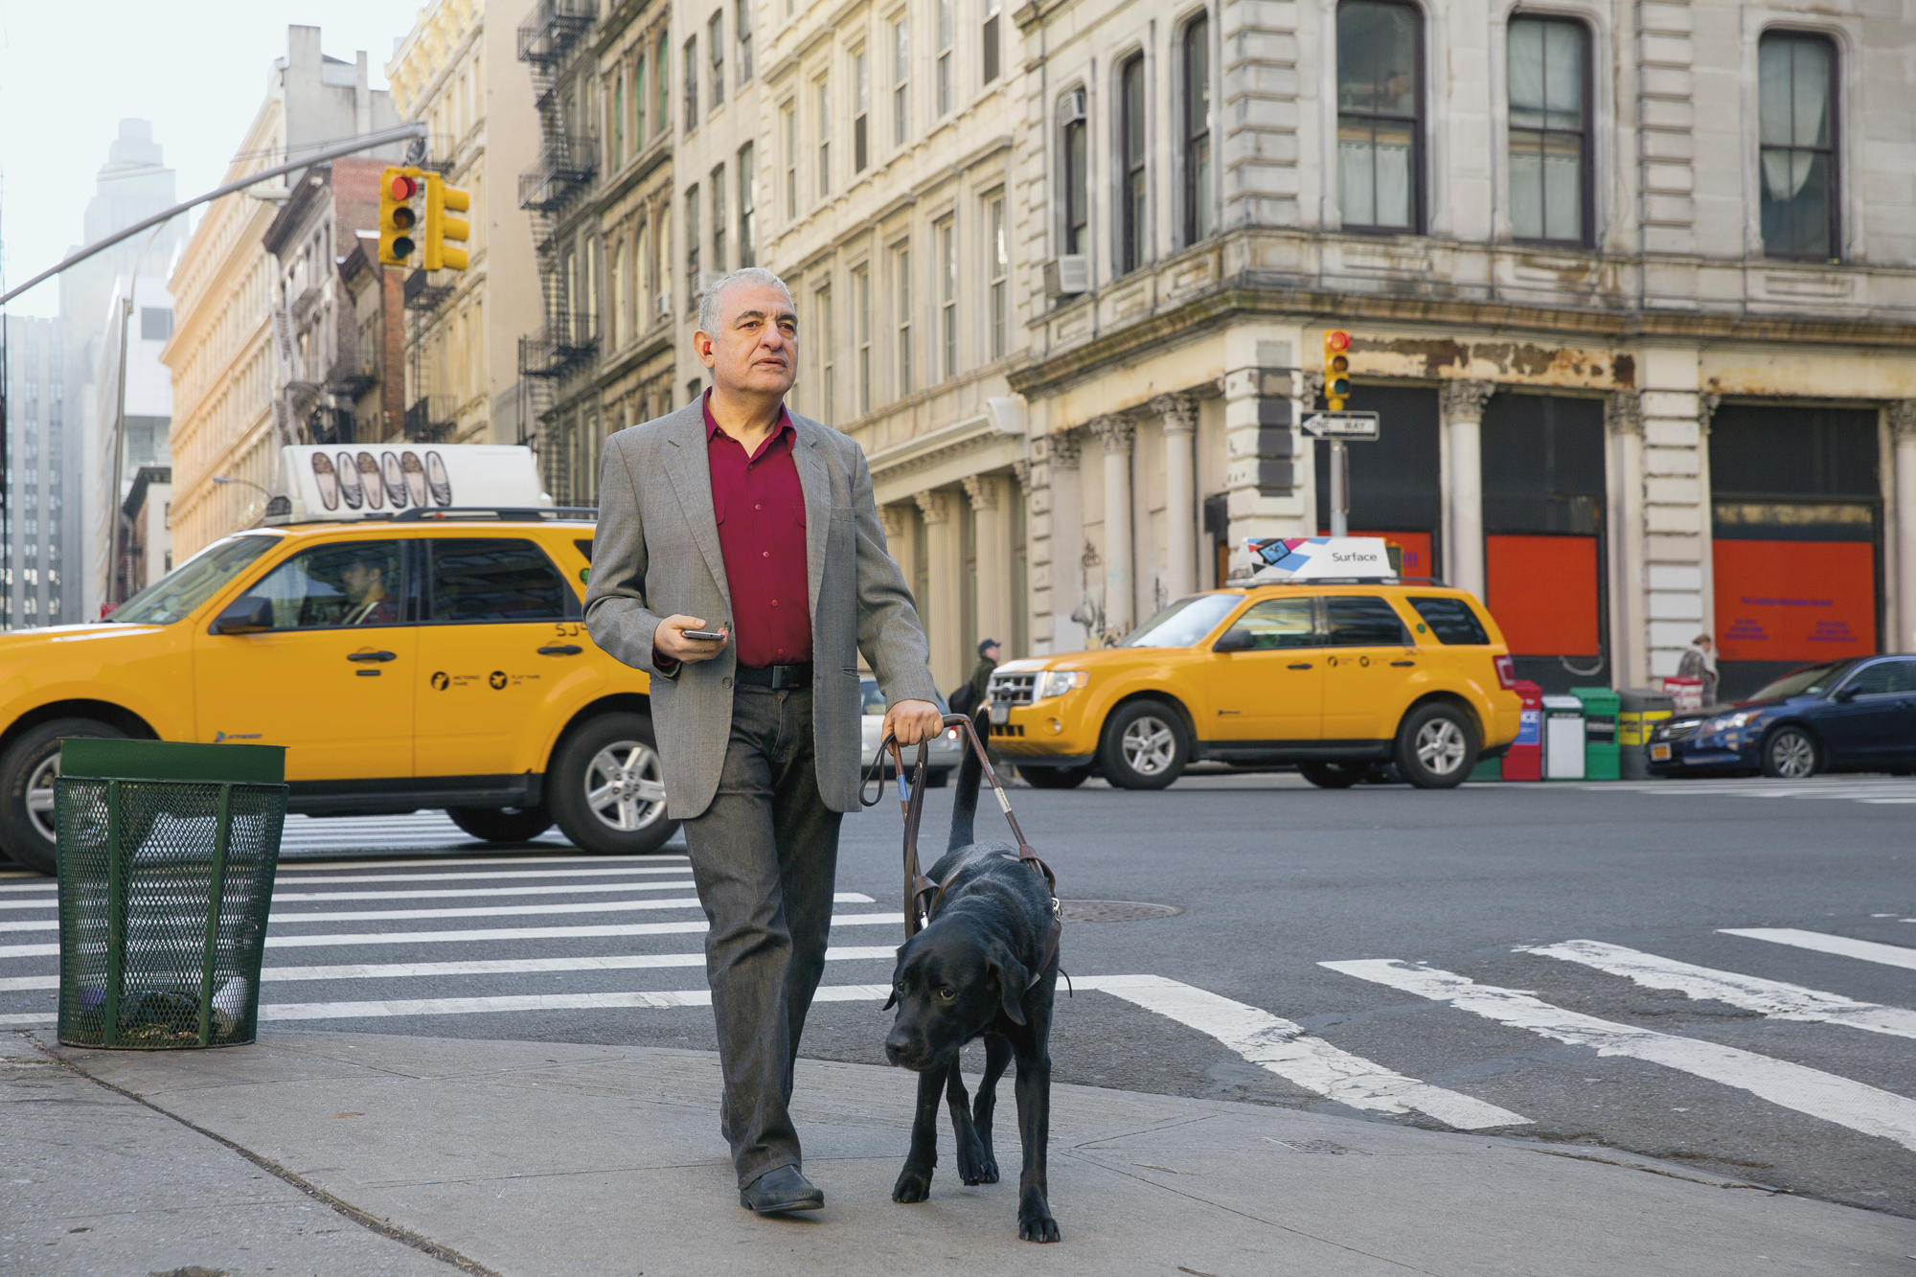
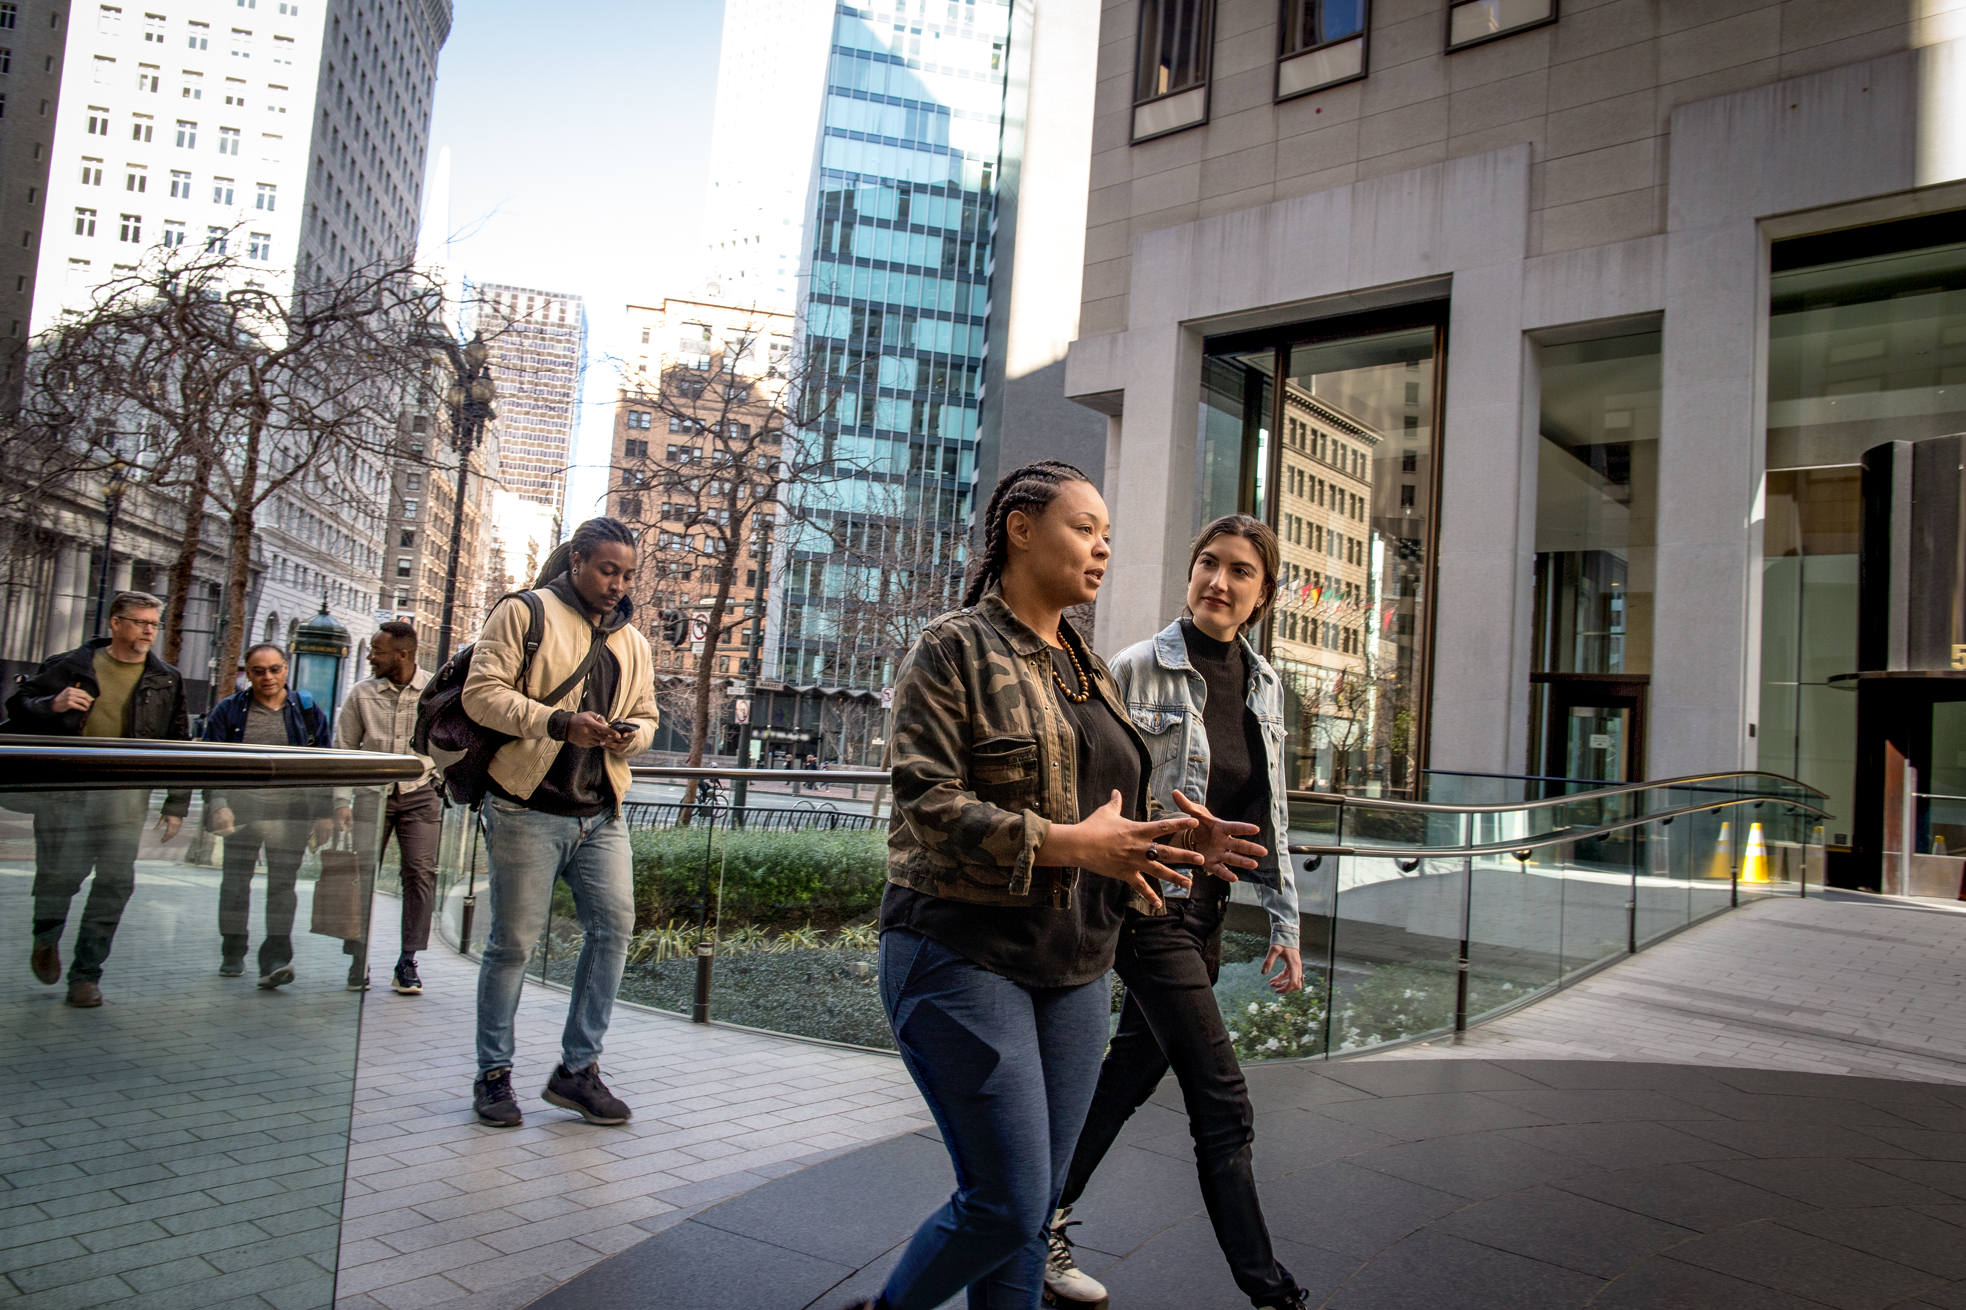
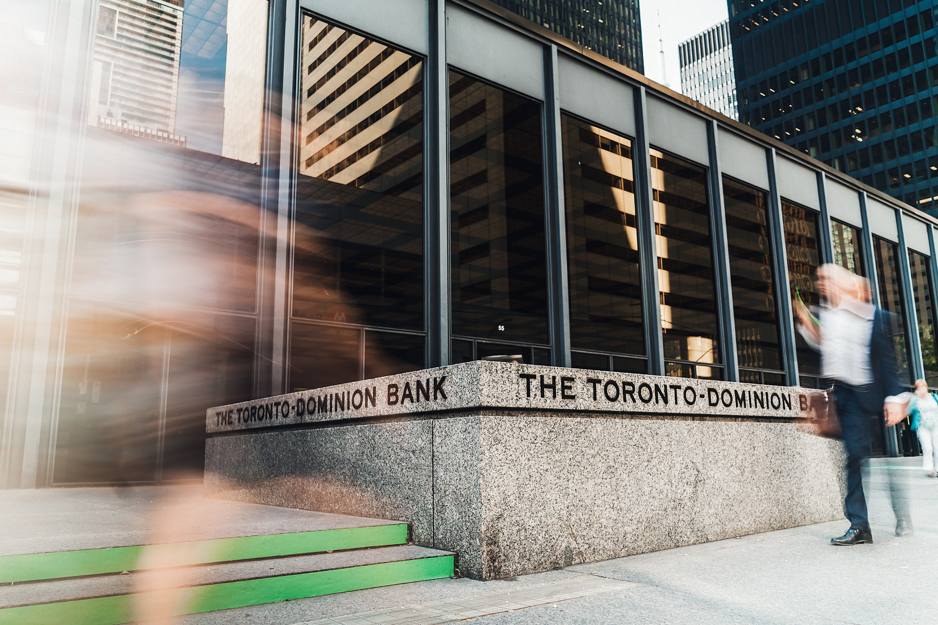
Applications of Computer Vision
Image Classification
Object Detection
Semantic Segmentation
bus
bus
Cyclist
car
bus
Taxi
Cyclist
car
cyclist
Image Analysis
Face Detection & Recognition
Optical Character Recognition
A person with a dog on a street
The Toronto Dominion Bank
Notes:
This is an animated slide – use the notes below to talk to each animation build
Most computer vision solutions are built using a combination of machine learning models and some advanced image analysis techniques. Common applications of computer vision include:
Image classification – An image classification model uses the numeric pixel features to predict a class label for the image. For example, in a traffic monitoring solution you might use an image classification model to classify images based on the type of vehicle they contain, such as taxis, buses, cyclists, and so on. Essentially, image classification models answer the question "what is this an image of?" {An image of a taxi with the label "Taxi" is shown}
Object detection – Object detection models are trained to classify individual objects in the image, and to indicate their location within the image as a bounding box. For example, you could expand the traffic monitoring solution to detect the presence of multiple classes of vehicle in an image. Object detection models are used to answer the question "what objects are in this image, and where are they?" {An image of a street with buses, cars, and cyclists indicated in bounding boxes is shown}
Semantic segmentation – Semantic segmentation models are an advanced kind of model that classify individual pixels in the image based on which object they belong to. For example, the traffic monitoring solution might use a semantic segmentation model to overlay "masks" on the image to indicate pixels that belong to buses, cars, and cyclists with different colors. Semantic segmentation answers the question "which pixels belong to which object?". {An image of a street with buses, cars, and cyclists overlaid with colored masks is shown}
Image Analysis – You can build on object detection and classification models to perform image analysis, generating captions and tags based on the image contents. {An image of a person and a dog on a street is shown with the caption "A person with a dog on a street"}
Face Detection and Recognition - Face detection is used to identify the location of human faces in an image. Further analysis can be performed on facial features to determine facial features, emotion, age, and so on; and models can be trained to identify specific individuals based on facial recognition. {An image of a group of people with their faces highlighted is shown}
Optical Character Recognition – An OCR model identifies regions of the image that contain text and extracts them. {An image of a building with the sign "The Toronto Dominion Bank" is shown with the text highlighted}

Slide 46
Lesson 2 Computer Vision in Azure

Slide 47




Cognitive Services
AI application resources in an Azure subscription:
Standalone resources for specific services
General Cognitive Services resource for multiple services
Consumed by applications via:
A REST endpoint (https:// address)
An authentication key
https://eastus/...
abc-1234-efg-5678…
Notes:
Azure provides a set of cognitive services that encapsulate common AI workloads – including computer vision tasks. You could build your own computer vision models using machine learning; but it's a complex area. Using off-the-shelf services can help you develop a solution more quickly and with less specialist expertise.
To use cognitive services, you must provision a resource in your Azure subscription. This can be a standalone, service-specific resource (for example, a Computer Vision resource) or a general Cognitive Services resource that encapsulates multiple services. Using a standalone service-specific resource enables you to manage costs and access to that service independently of other services you may be using, while a general Cognitive Services resource enables you to combine all of your AI services in a single Azure resource for centralized management. Regardless of the type of resource you use, client applications will consume the services it provides by connecting to a REST endpoint (an HTTPS address to which they can submit requests) using a resource-specific key for authentication.
In this course, students will use Python notebooks in an Azure Machine Learning workspace to run simple client applications. Students are not expected to be experienced developers or data scientists, so Python code and notebooks may be new to them. Reassure students that no coding experience is necessary – the Python code they'll use in the lab is provided for them. The key point of the course is to see some of the concepts in action, not to learn how to develop software.

Slide 48
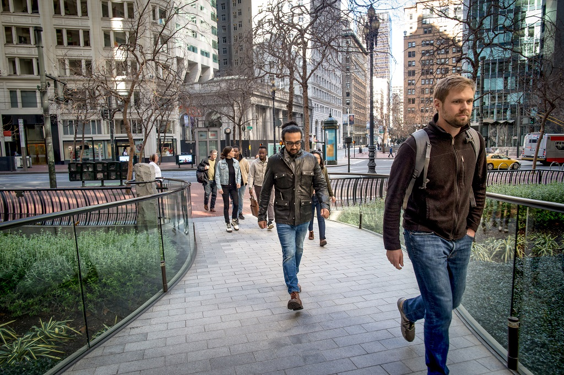
Image Analysis with the Computer Vision Service
Pre-trained computer vision model
Object detection for over 10,000 predefined classes
Image description and tag generation
Face detection and analysis
Content moderation
Text detection and OCR
person
person
Age 34
jeans
footwear
Caption: a group of people walking on a sidewalk
Tags: building, jeans, street, outdoor, jacket, city, person
Ratings: Adult: False, Racy: False, Gore: False
Notes:
The Computer Vision cognitive service provides a pre-trained computer vision model that you can use to analyze images. This service powered the demonstration in the previous lesson.
The model can:
Detect and locate over 10,000 classes of common object.
Generate an automatic caption for the image and a set of relevant tags that relate to its contents. Tags can be useful if you need to index images and search for them using relevant keywords.
Detect and analyze human faces.
Enable content moderation by identifying images that contain adult, racy, or gory content.
Detect and extract text in an image (we'll explore this in more depth later in the module).
In your own Azure Machine Learning workspace, use the Image Analysis with Computer Vision.ipynb notebook to demonstrate the Computer Vision service.

Slide 49
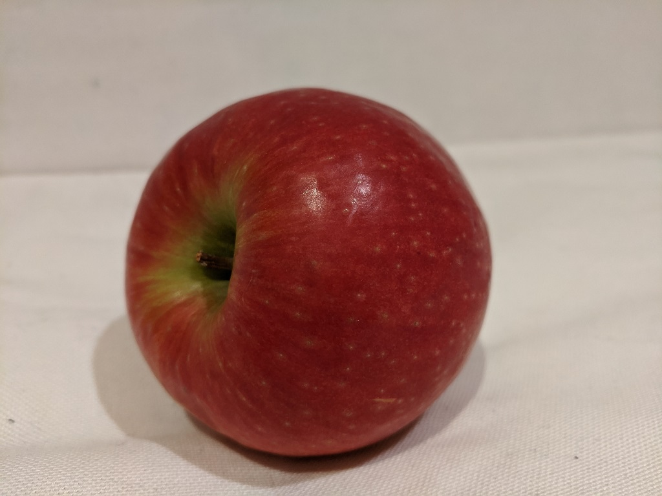
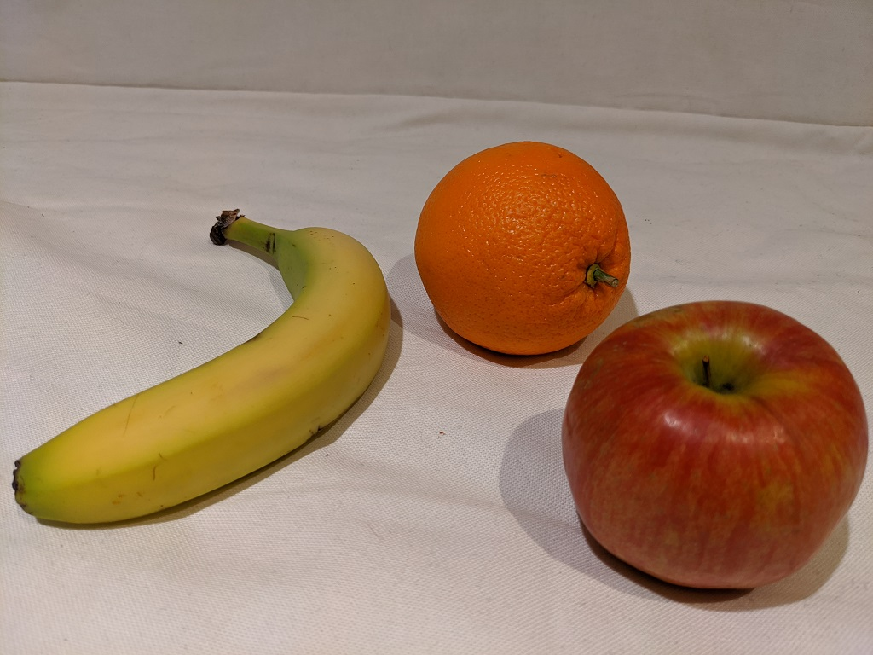
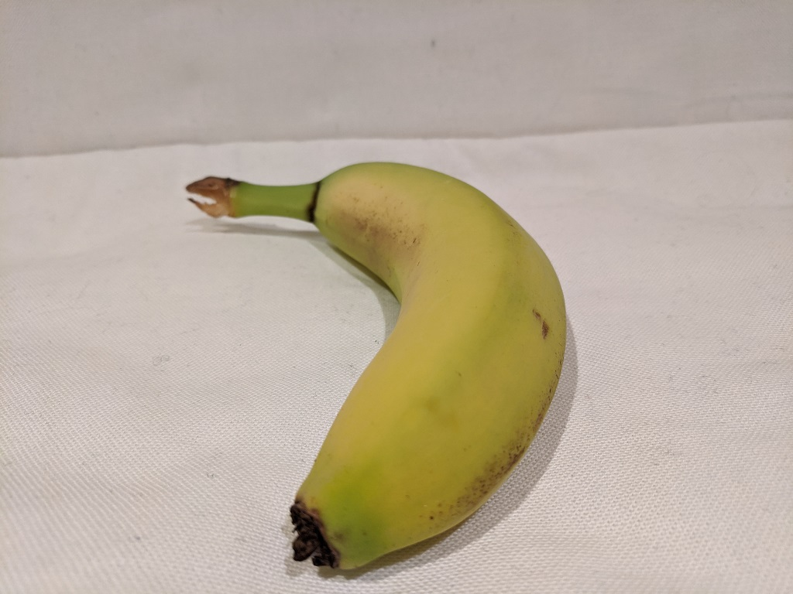
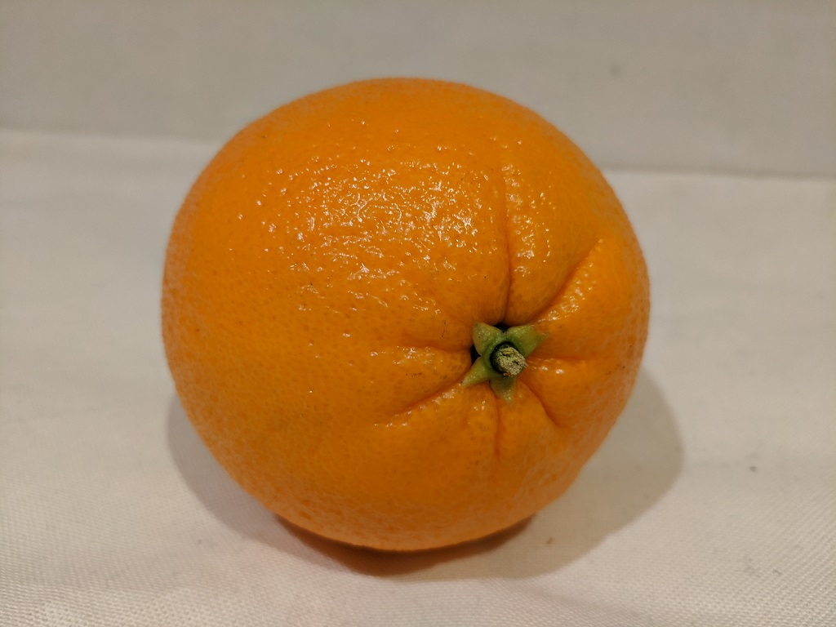
Training Models with the Custom Vision Service
Image Classification
Object Detection
Orange
Banana
Apple
Apple
Banana
Orange
Notes:
The Custom Vision cognitive services enables you to train a custom model for either image classification or object detection.
The service provides a web-based portal in which you can upload your own images, label the images or the objects in them, and train and deploy a model. You can then consume the model from a client application using its model ID with the endpoint and key for the resource in which you deployed it.
In your own Azure Machine Learning workspace, use the Image Classification.ipynb notebook and the customvision.ai portal to demonstrate classification with the Custom Vision service, explaining that students will explore this for themselves in the lab. Then use the Object Detection.ipynb notebook to demonstrate object detection.

Slide 50

Analyzing Faces with the Face Service
More facial analysis functionality than the Computer Vision service, including:
Facial attributes:
Age
Emotions
Facial recognition:
Similarity matching
Identity verification
Age 33
Age 31
Sama
Anisa
Happiness: 0.75
Happiness: 0.92
Notes:
While the Computer Vision service provides some basic face detection and analysis features, the Face service offers additional capabilities including analysis of facial attributes and the ability to compare faces for similarity, or even train a facial recognition model to verify the identities of individual
In your own Azure Machine Learning workspace, use the Face Analysis.ipynb notebook to demonstrate the Face service.

Slide 51
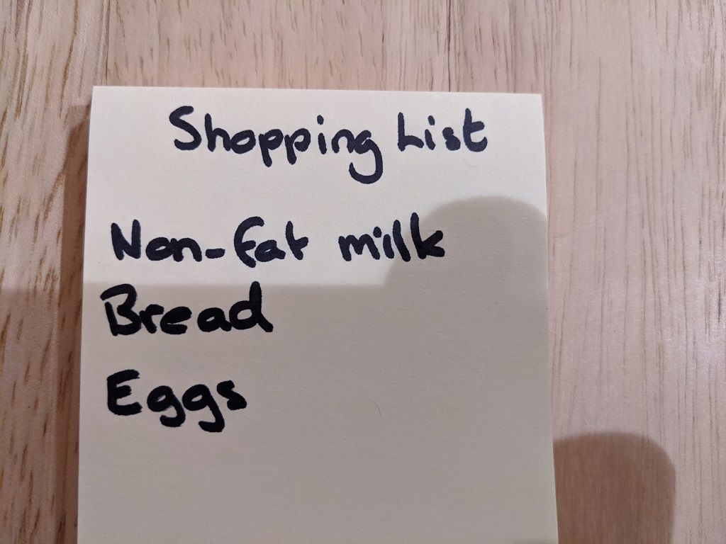
Reading Text with the Computer Vision Service
Detect the location of text:
Printed
Handwritten
Options for quick text extraction from images, or asynchronous analysis of larger scanned documents
Shopping List
Non-fat milk
Bread
Eggs
Notes:
We've already discussed the Computer Vision service and its use in image analysis. It also provides OCR capabilities to detect and extract text from images.
The service provides multiple application programming interfaces (APIs) that software developers can use to extract both printed and handwritten text from images, from immediate reading of small amounts of text in images to asynchronous text extraction from large documents.
In your own Azure Machine Learning workspace, use the Optical Character Recognition.ipynb notebook to demonstrate OCR with the Computer Vision service.

Slide 52
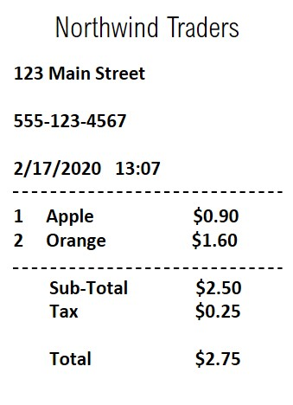
Analyzing Forms with the Form Recognizer Service
Extract information from scanned forms in image or PDF format
Train a custom model using your own forms
Use the pre-trained receipt model
Models perform semantic recognition of form fields – not just text extraction
Notes:
The Form Recognizer service offers more than just detecting and extracting text. It enables you to use models that "understand" the form fields – for example, identifying specific types of data such as addresses, phone numbers, dates, times, and quantities; and understanding the relationship between field labels and values.
You can use Form Recognizer to train your own custom form extraction models based on your own scanned forms, or you can use the pre-trained receipt model to extract information from scanned receipts.
In your own Azure Machine Learning workspace, use the Receipts with Form Recognizer.ipynb notebook to demonstrate the Form Recognizer service.

Slide 53
Natural Language Processing (NLP)

Slide 54


Lesson 1 Introduction to Natural Language Processing

Slide 55







What is Natural Language Processing?
 | Text analysis and entity recognition
 | Sentiment analysis
 | Speech recognition and synthesis
 | Machine translation
 | Semantic language modeling
Notes:
Natural language processing (NLP) is the area of AI that deals with making sense of written and spoken language.
The slide lists common NLP tasks:
Text analysis and entity recognition – Often you need to analyze a text document to determine its salient points or to identify entities it mentions, such as dates, places, people. For example, a company might use AI to analyze industry magazine articles to try to find articles that mention their products or executives or to determine the main subject of each article.
Sentiment analysis – This is a common form of text analysis that calculates a score indicating how positive (or negative) a text extract is. For example, a retailer might analyze reviews from customers to determine which ones are positive and which are negative.
Speech recognition and synthesis – It's increasingly common to encounter AI systems that can recognize spoken language as input and synthesize spoken output. For example, an in-car system might enable hands-free communication by reading incoming text messages aloud and enabling you to verbally dictate a response.
Machine translation – International and cross-cultural collaboration is often a key to success, and this requires the ability to eliminate language barriers. AI can be used to automate translation of written and spoken language. For example, an inbox add-in might be used to automatically translate incoming or outgoing emails, or a conference call presentation system might provide a simultaneous transcript of the speaker's words in multiple languages.
Semantic language modeling – Language can be complex and nuanced, so that multiple phrases might be used to mean the same thing. For example, a driver might ask "Where can I get gas near here?", "What's the location of the closest gas station?", or "Give me directions to a gas station." All of these mean essentially the same thing, so a semantic understanding of the language being used is required to discern what the driver needs. An automobile manufacturer could train a language model to understand phrases like these and respond by displaying appropriate satellite navigation directions.

Slide 56
Natural Language Processing in Azure
Cognitive Services
Text Analytics | Language detection Key phrase extraction Entity detection Sentiment analysis
Speech | Text to speech Speech to text Speech translation
Translator Text | Text translation
Language Understanding | Custom language modeling
Notes:
Relate the services in this slide back to the NLP tasks on the previous slide.
You could build your own custom NLP models using machine learning or NLP toolkits for various programming languages - particularly Python (commonly used Python packages for NLP include NLTK, Gensim, and SpaCy); but it's a complex area. Using off-the-shelf services can help you develop a solution more quickly and with less specialist expertise.
We're going to explore all of these services in the next lesson.

Slide 57
Lesson 2 Using Natural Language Processing Services

Slide 58
Text Analytics
Predominant Language: English
Sentiment: 88% (positive)
Key Phrases: "wonderful vacation"
Entities: France
I had a wonderful vacation in France.
Notes:
This is an animated slide – use the notes below to talk to each animation build
The Text Analytics service, as its name suggests, is used to analyze text documents. The demonstration in the previous lesson used this service.
For example, suppose you use the Text Analytics service to analyze the text "I had a wonderful vacation in France" {The text "I had a wonderful vacation in France" appears}
The service can determine the language the text is written in, {The bullet "Predominant Language: English" appears}
It can evaluate the sentiment of the text, {The bullet "Sentiment: 88% (positive)" appears}
It can detect key phrases used in the text {The bullet "Key Phrases: "wonderful vacation"" appears}
And it can identify known entitites that are mentioned {The bullet "Entities: France" appears}
In your own Azure Machine Learning workspace, use the Text Analytics.ipynb notebook to demonstrate the Text Analytics service.

Slide 59

Speech Recognition and Synthesis
Use the speech-to-text capabilities of the Speech service to transcribe audible speech to text
Use the text-to-speech capabilities of the Speech service to generate audible speech from text
Notes:
This is an animated slide – use the notes below to talk to each animation build
The Speech service provides a Speech-to-Text API that you can use to implement text recognition functionality. The service supports text transcription in more than 60 languages. {A speech bubble with an arrow pointing to the text "Use the speech-to-text capabilities of the Speech service to transcribe audible speech to text" is displayed}
Conversely, the Text-to-Speech API can synthesize audible speech from text, with the option to specify regionally appropriate voices for human-like pronunciation {The text "Use the text-to-speech capabilities of the Speech service to generate audible speech from text" is displayed with an arrow pointing to a speech bubble}
In your own Azure Machine Learning workspace, use the Speech.ipynb notebook to demonstrate the Speech service (if you are delivering the class virtually over a conference call system such as Teams, you may need to set up your system so that audio is played through your speakers and picked up by your microphone)

Slide 60
Translation
Translator Text service
Bonjour
Hello
Hola
Speech service
Hello
你好
Notes:
This is an animated slide – use the notes below to talk to each animation build
The Translator Text service enables you to translate text between more than 60 languages. {The text "Bonjour" is shown being submitted to the Translator Text service, which produces the result "Hello"}
You can also translate audible speech by using the Speech service, which has the ability to produce translated output in text or audio format. {A speech "Hello" bubble is submitted to the Speech service resulting in a "Hola" text box and a "你好" speech bubble}
In your own Azure Machine Learning workspace, use the Translation.ipynb notebook to demonstrate translation with the Translator Text and Speech services (if you are delivering the class virtually over a conference call system such as Teams, you may need to set up your system so that audio is played through your speakers and picked up by your microphone)

Slide 61


Language Understanding
Switch the light on.
Entity
Intent
Utterance
Notes:
This is an animated slide – use the notes below to talk to each animation build
The Language Understanding service enables you to train a language model that can interpret natural language commands.
The language model consists of three primary components:
Utterances are phrases that a user might say or type – for example, "switch the light on".
Entities are specific items that are referenced in an utterance, for example a language model for a home automation application might recognize household devices such as a light or a fan.
An intent identifies the desired action for an utterance. For example, to switch something on.
In your own Azure Machine Learning workspace, use the Language Understanding.ipynb notebook and the www.luis.ai portal to demonstrate Language Understanding. Point out that students will try this for themselves in the lab.

Slide 62
Conversational AI

Slide 63

Lesson 1 Conversational AI Concepts

Slide 64
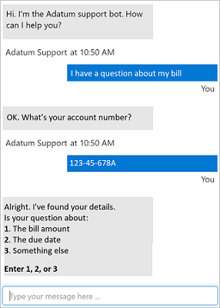
What is Conversational AI?
A solution that enables a dialog between an AI agent and a human
Generically, conversational AI agents are known as bots
Bots can engage over multiple channels:
Web chat interfaces
Email
Social media platforms
Voice
Notes:
Conversational AI builds on other AI workloads, in particular natural language processing but also machine learning and potentially computer vision. In general, when people use the term "conversational AI", they're referring to bots.
People often associate the term "bot" with a chat interface on a website, but actually this is just one (very common) way to interact with a bot. Bots can be connected to multiple channels, including email, social media, telephone and so on.
Bots are used in multiple different scenarios, such as:
Customer support: for example, answering frequently asked questions or gathering information before handing off to a human customer service representative.
Reservation systems: for example, enabling users to book cinema tickets, flights, or restaurant tables.
Digital assistants: for example, an in-home or cellphone-based virtual assistant that can perform tasks based on instructions.
Online ordering: for example, ordering takeout food for delivery, or products from an online retailer.
Healthcare: for example, providing an automated diagnosis based on symptoms.
Office productivity: for example by helping users find relevant corporate resources for a particular task.
Ask students to suggest other scenarios where they've encountered bots.

Slide 65
Responsible AI Guidelines for Bots
Be transparent about what the bot can (and can't) do
Make it clear that the user is communicating with a bot
Enable the bot to seamlessly hand-off to a human if necessary
Ensure the bot respects cultural norms
Ensure the bot is reliable
Respect user privacy
Handle data securely
Ensure the bot meets accessibility standards
Assume accountability for the bot's actions
Notes:
These guidelines are based on the guidance at https://www.microsoft.com/research/publication/responsible-bots/
You can also find interactive guidance at https://aidemos.microsoft.com/responsible-conversational-ai/building-a-trustworthy-bot.

Slide 66
Lesson 2 Conversational AI in Azure

Slide 67

The QnA Maker Service
Define a knowledge base of question and answer pairs:
By entering questions and answers
From an existing FAQ document
By using built-in chit-chat
Consume the knowledge base from client apps, including bots
?
!
Notes:
The QnA Maker is a cognitive service that enables you to define a knowledge base of question and answer pairs. You can create the knowledge base by entering questions and answers, or you can import an existing Frequently Asked Questions (FAQ) list. You can also augment your questions and answers with built in chit-chat sources that include common conversational exchanges.
After creating the knowledge base, you train a model based on the question and answer data and publish it as a service. Client applications, an in particular bots, can then consume the knowledge base and use it to determine appropriate responses to user input.
Show students the Knowledge Base you created when completing the online module in the QnA Maker portal.

Slide 68




Azure Bot Service
?
!
Cloud-based platform for developing and managing bots
Integration with LUIS, QnA Maker, and others
Connectivity through multiple channels
Notes:
Azure Bot Service provides a platform for creating, deploying, and managing bots. With the Azure Bot Service, developers can use the Microsoft Bot Framework SDK to develop bots and easily deploy and manage them in Azure.
By using the Azure bot Service, you can easily integrate your bot with Azure cognitive services like Language Understanding and QnA Maker, and connect your bot to multiple channels such as webchat, email, Microsoft Teams, and others.
In the Azure portal, show students the bot you created from your knowledge base in the online module. Then in your Codespace, use the QnA Bot.ipynb notebook to demonstrate the bot running in a web chat interface.

Slide 69
Exam AI-900 Strategy

Slide 70
Tim's Certification Study Pyramid
Interdependence
Content knowledge
Practical application
Test-taking skills

Slide 71
Item Types

Slide 72

Single Answer Multiple Choice

Slide 73

Multiple Answer Multiple Choice

Slide 74
Repeated Scenario
You need to move an Azure VM to another hardware host.
Solution: You redeploy the VM.
Does this solution meet the goal?
Yes
No

Slide 75
Repeated Scenario
You need to move an Azure VM to another hardware host.
Solution: You enable boot diagnostics.
Does this solution meet the goal?
Yes
No

Slide 76

Select and Place

Slide 77

Build List and Reorder

Slide 78

Active Screen/Fill in the Blank

Slide 79

Case Study

Slide 80






Performance-Based Lab

Slide 81
Microsoft Online Testing

Slide 82
Tim's Online Testing Video (YouTube)
timw.info/online

Slide 83

Microsoft Online Testing Process

Slide 84

Microsoft Online Testing Process

Slide 85

Microsoft Online Testing Process

Slide 86

Microsoft Online Testing Process

Slide 87

Microsoft Online Testing Process

Slide 88

Microsoft Online Testing Process

Slide 89

Microsoft Online Testing Process

Slide 90
AI-900 Practice Questions

Slide 91
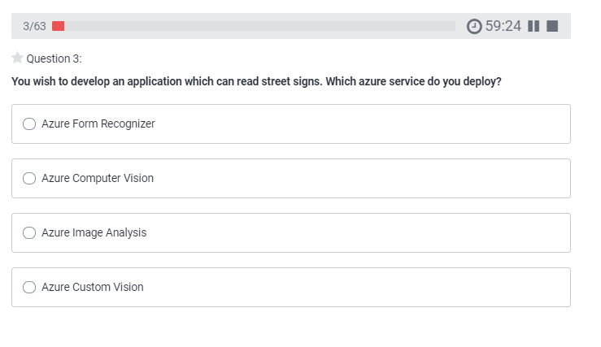
AI-900 Practice Question
timw.info/udemy

Slide 92
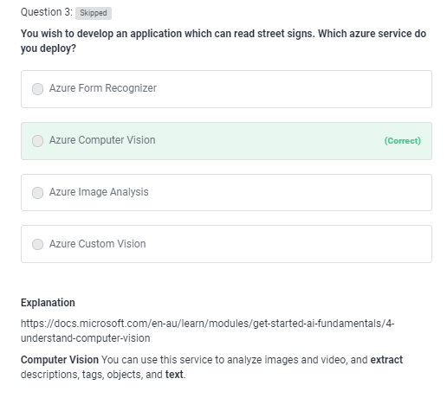
AI-900 Practice Question
timw.info/udemy

Slide 93
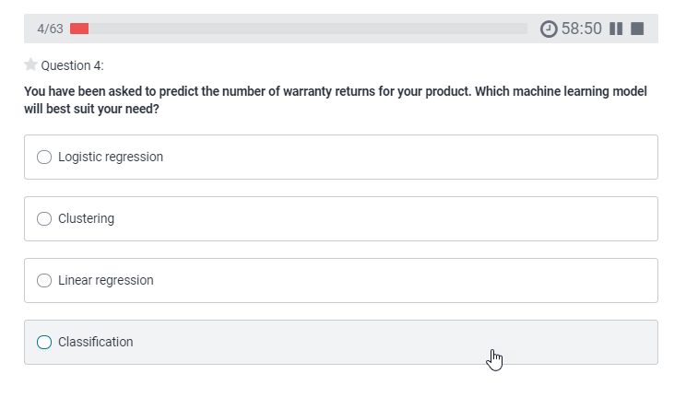
AI-900 Practice Question
timw.info/udemy

Slide 94
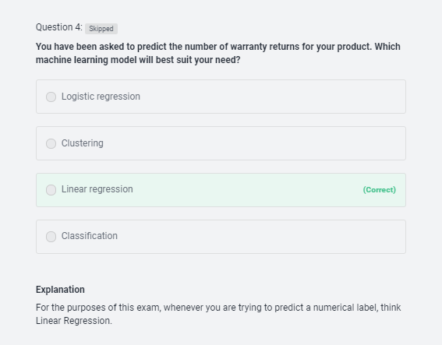
AI-900 Practice Question
timw.info/udemy

Slide 95
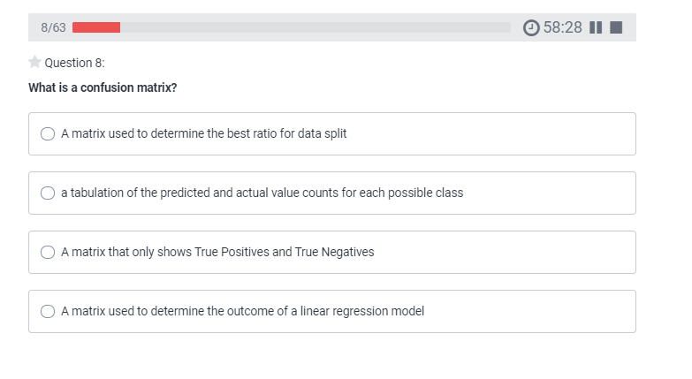
AI-900 Practice Question
timw.info/udemy

Slide 96
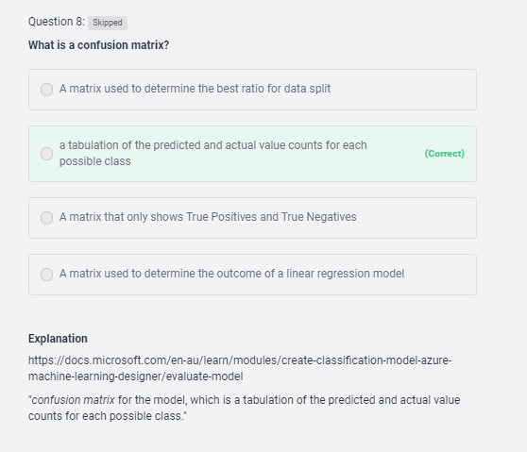
AI-900 Practice Question
timw.info/udemy

Slide 97
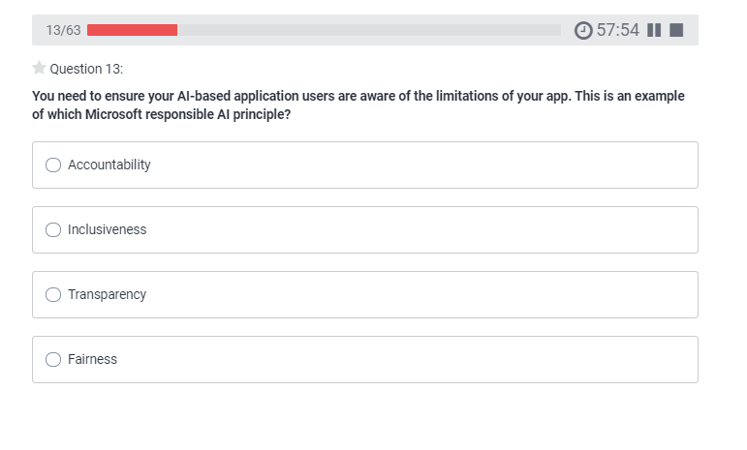
AI-900 Practice Question
timw.info/udemy

Slide 98
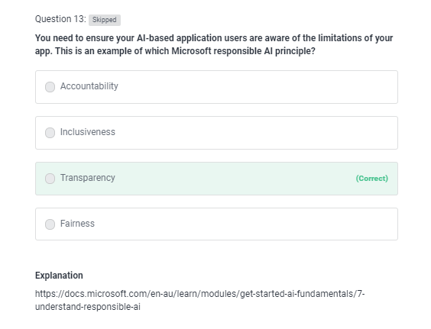
AI-900 Practice Question
timw.info/udemy

Slide 99
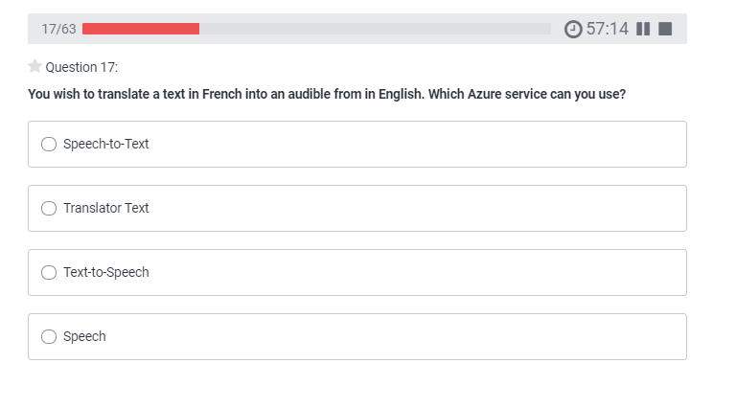
AI-900 Practice Question
timw.info/udemy

Slide 100
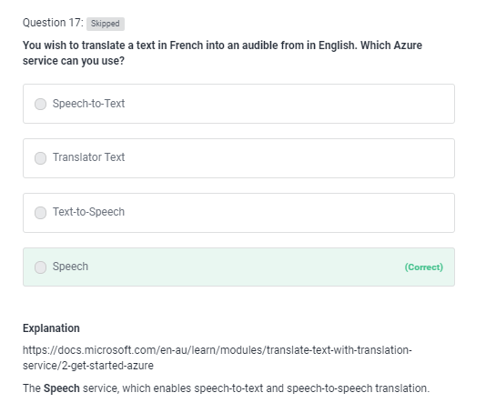
AI-900 Practice Question
timw.info/udemy

Slide 101
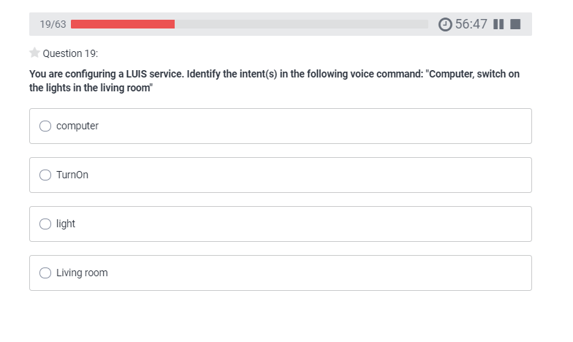
AI-900 Practice Question
timw.info/udemy

Slide 102
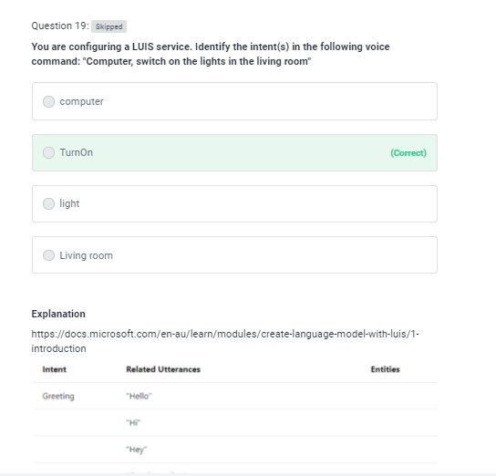
AI-900 Practice Question
timw.info/udemy

Slide 103
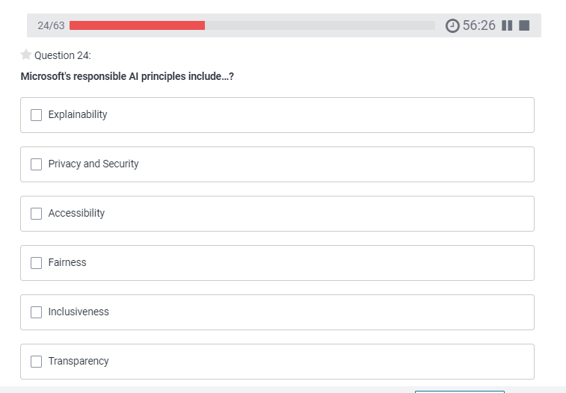
AI-900 Practice Question
timw.info/udemy

Slide 104
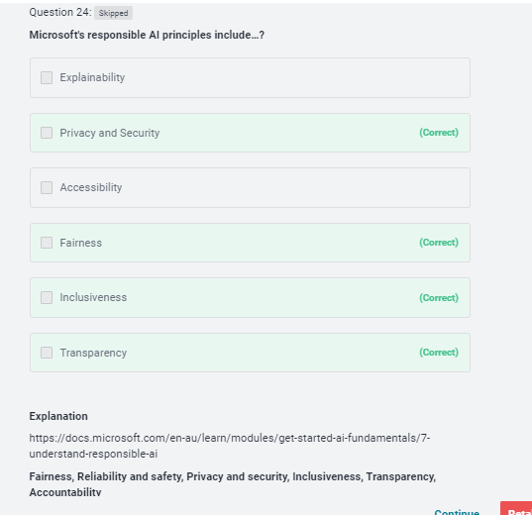
AI-900 Practice Question
timw.info/udemy

Slide 105
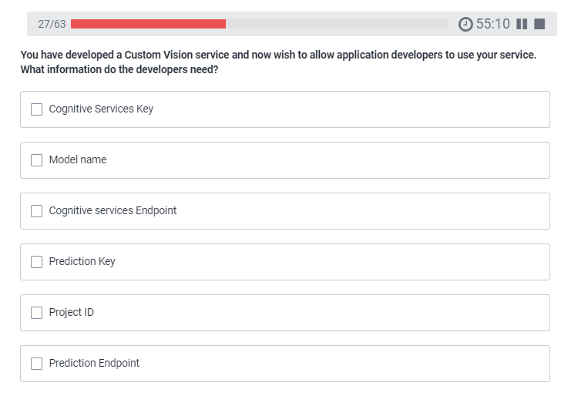
AI-900 Practice Question
timw.info/udemy

Slide 106
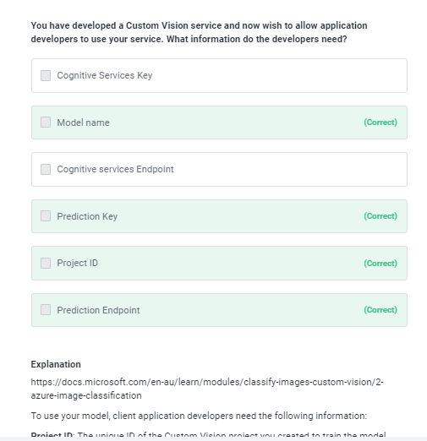
AI-900 Practice Question
timw.info/udemy

Slide 107
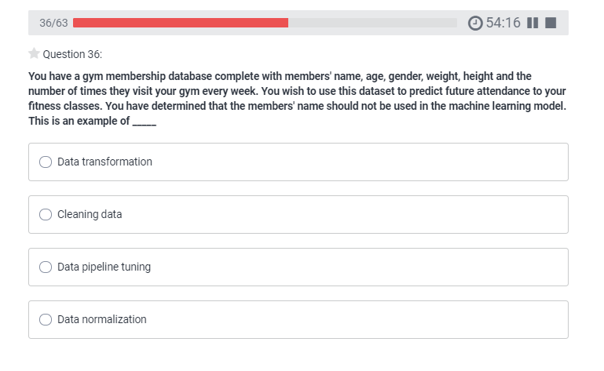
AI-900 Practice Question
timw.info/udemy

Slide 108
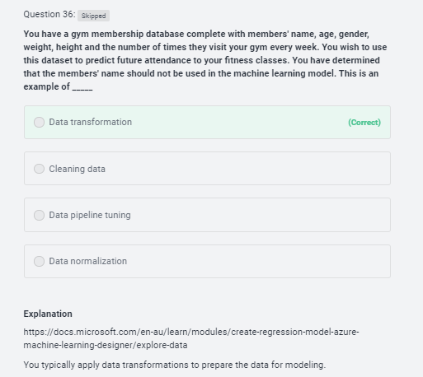
AI-900 Practice Question
timw.info/udemy

Slide 109
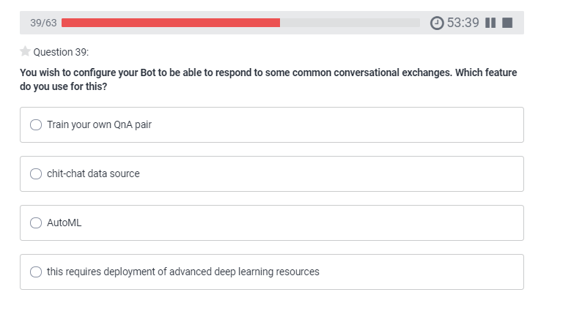
AI-900 Practice Question
timw.info/udemy

Slide 110
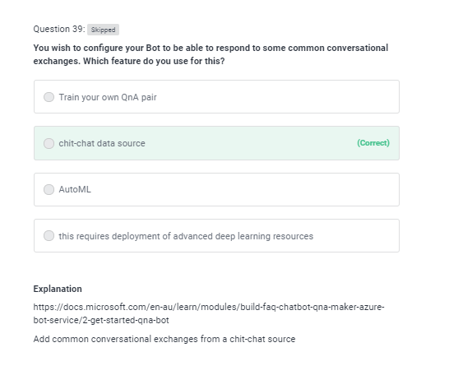
AI-900 Practice Question
timw.info/udemy

Slide 111
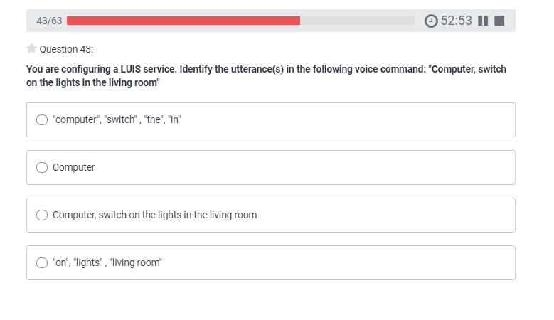
AI-900 Practice Question
timw.info/udemy

Slide 112
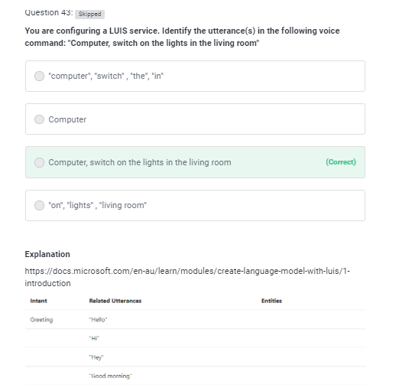
AI-900 Practice Question
timw.info/udemy

Slide 113
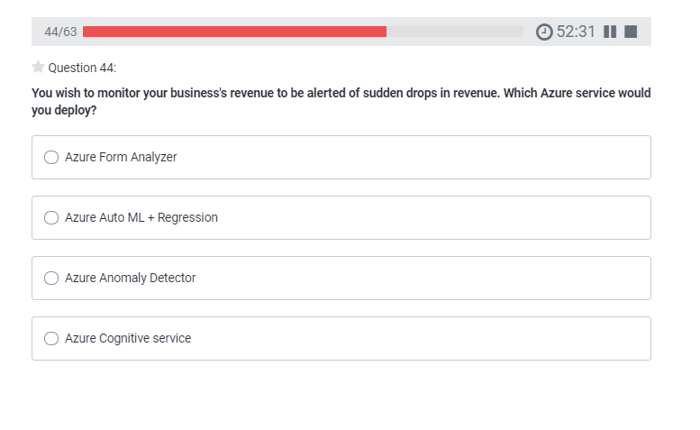
AI-900 Practice Question
timw.info/udemy

Slide 114

AI-900 Practice Question
timw.info/udemy

Slide 115

AI-900 Practice Question
timw.info/udemy

Slide 116

AI-900 Practice Question
timw.info/udemy

Slide 117

AI-900 Practice Question
timw.info/udemy

Slide 118

AI-900 Practice Question
timw.info/udemy

Slide 119

AI-900 Practice Question
timw.info/udemy

Slide 120

AI-900 Practice Question
timw.info/udemy

Slide 121

AI-900 Practice Question
timw.info/udemy

Slide 122

AI-900 Practice Question
timw.info/udemy

Slide 123

AI-900 Practice Question
timw.info/udemy

Slide 124

AI-900 Practice Question
timw.info/udemy

Slide 125

AI-900 Practice Question
timw.info/udemy

Slide 126

AI-900 Practice Question
timw.info/udemy

Slide 127

AI-900 Practice Question
timw.info/udemy

Slide 128

AI-900 Practice Question
timw.info/udemy

Slide 129

AI-900 Practice Question
timw.info/udemy

Slide 130

AI-900 Practice Question
timw.info/udemy

Slide 131
Thank you!
Twitter: @TechTrainerTim
Courses: timw.info/ps
Web: TechTrainerTim.com

Slide 132
Responsible AI

Slide 133
Microsoft's Position on AI Use
"We are committed to the advancement of AI driven by ethical principles that put people first."
Reference: https://timw.info/01bdb

Slide 134

Responsible AI Principles
AI systems should treat all people fairly
AI systems should perform reliably and safely
AI systems should be secure and respect privacy
AI systems should empower everyone and engage people
AI systems should be understandable
Examples: https://timw.info/rai
People should be accountable for AI systems
https://timw.info/880e4

Slide 135


Responsible AI
Compliance Manager
https://timw.info/84db2

Slide 136
Azure Cognitive Services

Slide 137


First Things First
Cognitive Services multi-service account
Azure Functions
https://timw.info/89e3b

Slide 138


How To Know Cognitive Services

Slide 139


How To Know Cognitive Services

Slide 140

Computer Vision
Digital Asset Management (DAM) solution for image data
Detect objects and features
Detect corporate brands/logos
Describe an image
Optical character recognition (OCR)
Generate thumbnail
https://timw.info/bb965

Slide 141

Face
Facial recognition
Facial verification
Emotion recognition
Person Group containers:
Person Group (10,000 persons)
Large Person Group (1M persons)
https://timw.info/31118

Slide 142

Video Indexer
Extract meaning from video and audio files
Index faces and spoken words
Great for making content available to vision- or hearing-challenged users
Content moderation
Azure Media Services
Encoding
https://timw.info/d0b4b

Slide 143

Content Moderator
Checks text, image, and video content for potentially undesirable content
Profanity
Adult or "racy" content
https://timw.info/7eec2

Slide 144

Speech
Speech-to-text: Transcribe audio from >40 languages
Speaker recognition:
Voice signature
https://timw.info/18876

Slide 145

Text Analytics
Language detection
Sentiment analysis
Entity extraction
People
Places
Organizations
Objects
Translator: 60 languages
https://timw.info/87290

Slide 146

Azure Cognitive Search
https://timw.info/c6ab1

Slide 147

Bing Web Search
Retrieve answers from Bing search engine
Web pages
Images
Videos
News
https://timw.info/7640a

Slide 148
Azure Bot Service

Slide 149

What is a Bot?
Chatbot
Computer programmed designed to mimic human interaction
Turn based text/audio conversation
Alternative UI
Language Understanding Intelligent Service (LUIS)
Cortana

Slide 150

Azure Bot Service
Toolset to develop "intelligent agents"
Graphical:
Bot Framework Composer
Code:
Bot Framework SDK
C#, Python, JavaScript, Java
https://timw.info/87290

Slide 151

Chatbot
https://timw.info/b04eb

Slide 152

Conversational Bot
https://timw.info/32e9e

Slide 153
Monitoring

Slide 154

Azure Monitoring
https://timw.info/azmon

